Slide 1
Stage 3 Term 4 - Week 1
Thursday 7th of October 2021

Slide 2
Week 1 Spelling Lists
Look Cover Say Write Check your spelling words in your book, identifying the syllables for each word, like you do in class (must use at least two colours or dashes).
Then complete one activity from the spelling choice board.

Slide 3
Week 1 Words
Revision of Term 3 Words
 |  | Starfish | Seahorses | Turtles | Dolphins | Stingrays | Sharks
 | 1 | ever | glow | hoarder | jungle | almost | octagonal
 | 2 | term | marrow | uproar | crumble | awarded | tactile
 | 3 | silver | shadow | cupboard | anymore | partnership | contagious
 | 4 | royal | squeal | poorest | freckle | vegetarian | circumstantiate
 | 5 | oyster | preach | moor | somersault | pedestrian | auditorium
 | 6 | hoist | beast | boar | laundry | spectacular | visualise
 | 7 | decay | threw | adore | fascinate | linear | aqueous
 | 8 | waist | coward | score | crescent | sibling | improvise
 | 9 | afraid | scowl | tore | scenery | inkling | percent
 | 10 | lung | gown | court | embalm | sanctuary | supervise
 | 11 | spring | screw | fourth | calves | boundary | circumstantial
 | 12 | porch | spew | poured | qualm | category | audible
 | 13 | thorn | rescue | bruise | folk | inventory | aquarium
 | 14 | foil | duel | sledge | vague | directory | entanglement
 | 15 | spoil | cue | porridge | disguise | unsatisfactory | octennial
 | 16 | wail | drew | recruitment | guilty | compulsory | tangible

Slide 4
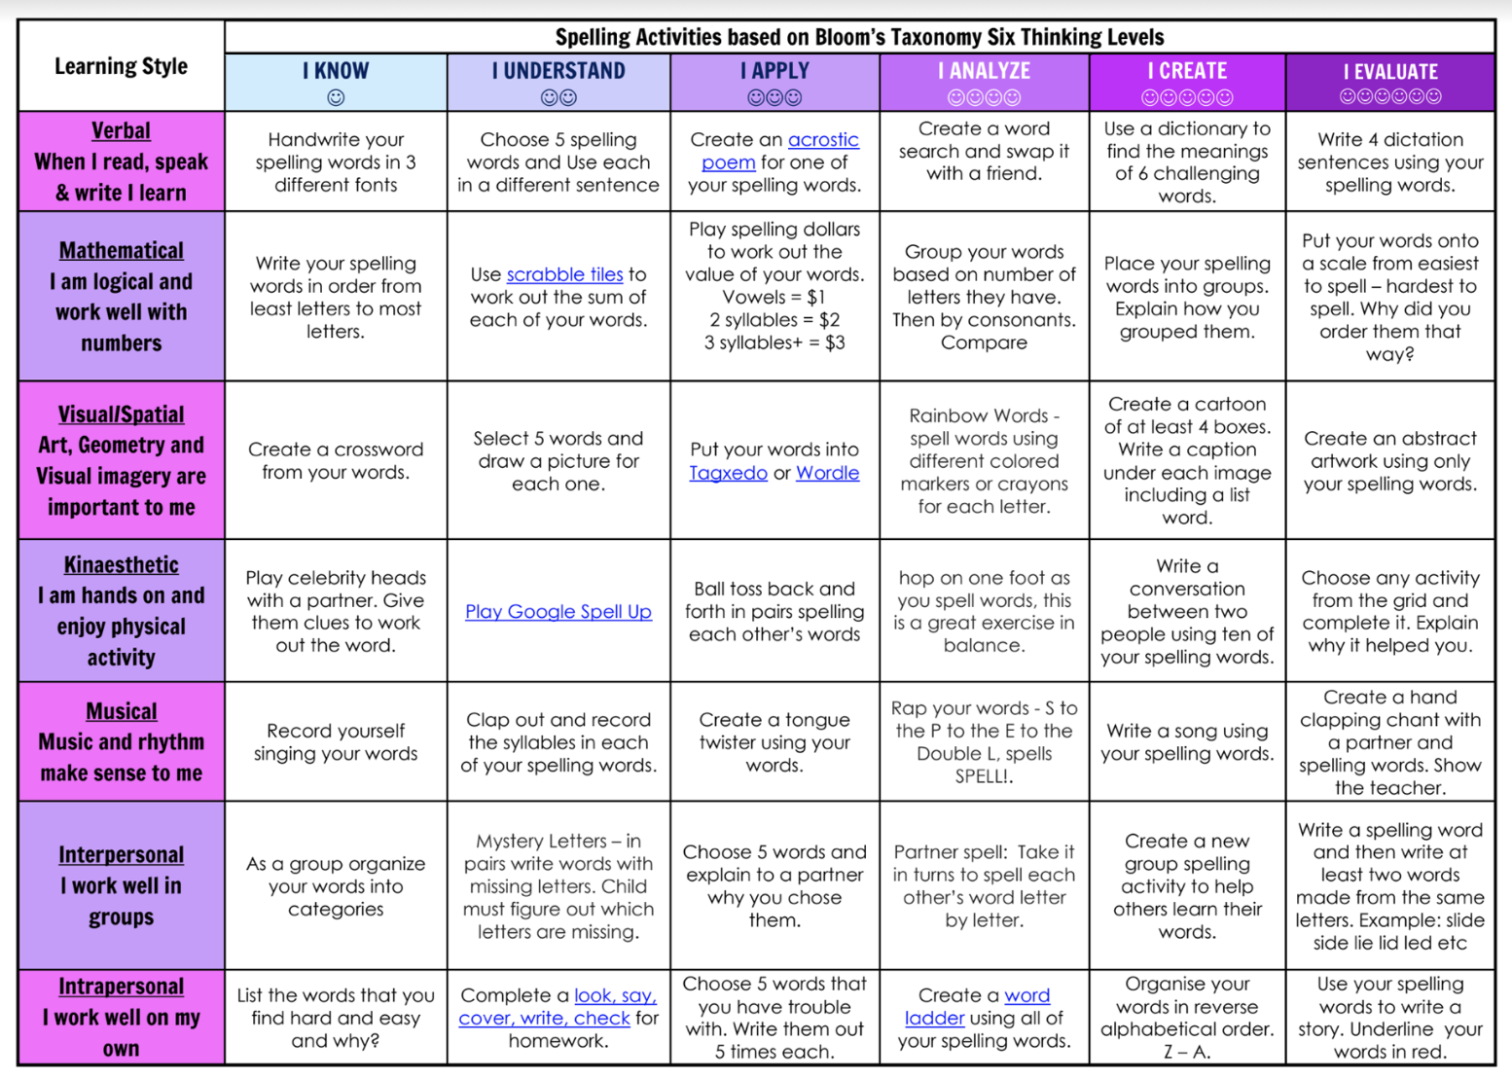
Spelling (20 minutes) - Look Cover Say Write Check your words. Complete an activity from the Spelling Choice Board.

Slide 5
Fruit Break/ Brain Break
Grab a piece of fruit or have a 10 minute break to go outside reset, refresh and restart.

Slide 6
Read works and Read Theory
Complete the reading passage and comprehension questions that have been provided by your class teacher in the google classroom.
This should take you 40-45 minutes to complete.

Slide 7
Learning Support
If you are working with Ms Carrington, Mrs Waggie or Mrs McCormick in Term 3, you will find your work in the Learning Support Google Classroom.
Everyone else, please go to the next slide.

Slide 8
Lunch break - Break 1
Enjoy the 30 minute lunch break with your family.
Try to eat something healthy and drink some water.

Slide 9
Middle Session
Numeracy: Numeracy Ninjas
Week 1 : Session 1

Slide 10
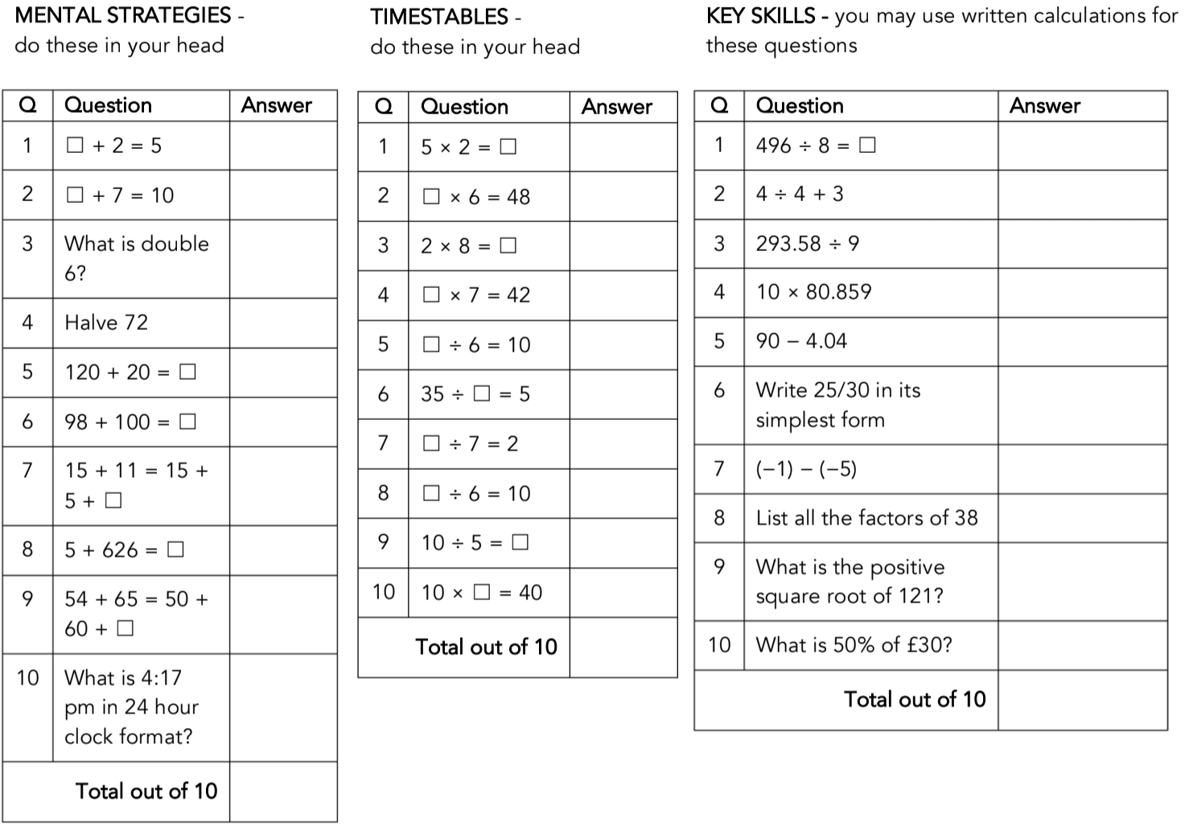
Numeracy Ninjas
You have 5-10 minutes to complete the questions.
Numeracy Ninjas Week 20 Session 1

Slide 11
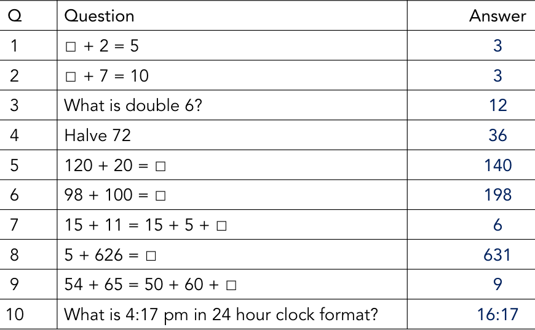
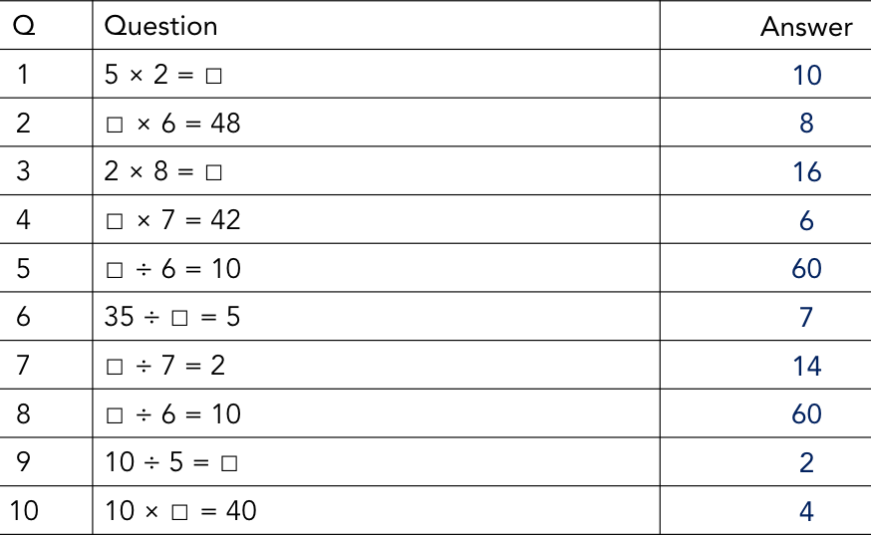
Numeracy Ninjas ANSWERS
Mental Strategies
Times Tables
Numeracy Ninjas Week 20 Session 1
Notes:
Week 17 Session 1
Mental Strategies Answers

Slide 12
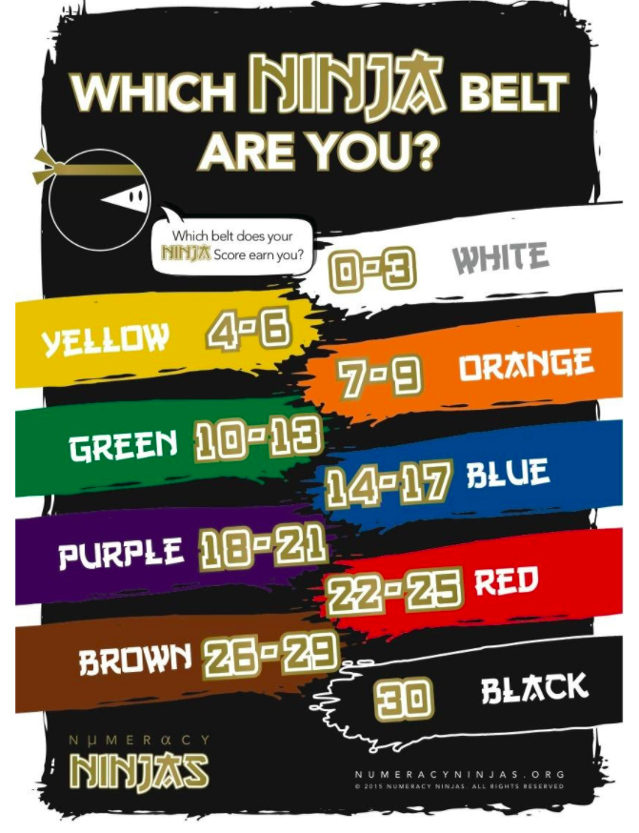
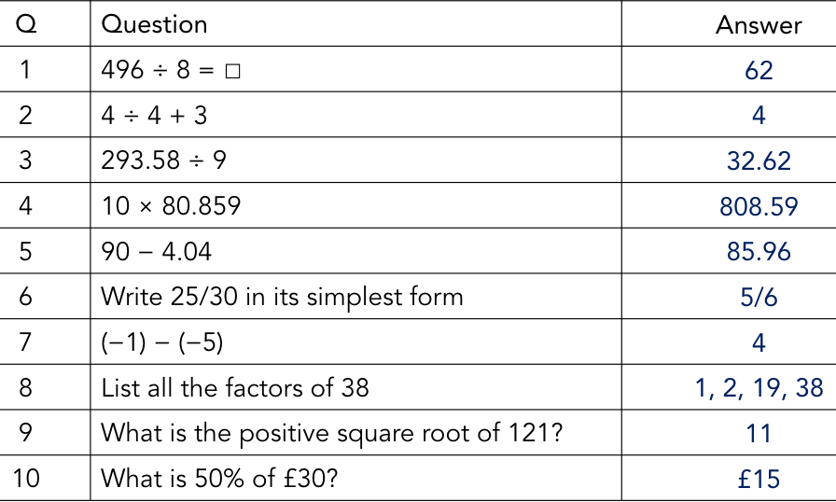
Numeracy Ninjas ANSWERS
Key Skills
Numeracy Ninjas Week 20 Session 1

Slide 13
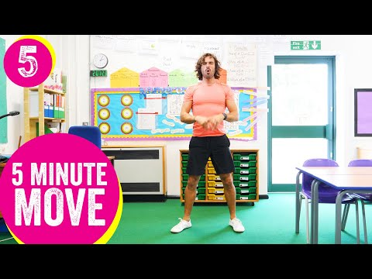
Brain Break
Let’s get our bodies moving and try this 5-minute workout.
Make sure you have a big drink of water afterwards!

Slide 14
Matific
Go to https://www.matific.com/au/en-au/login-page/
Complete tasks on matific

Slide 15
Break 2: 30 minutes
Go outside.
Take this opportunity to run around outdoors.
Recharge and have a quick bite to eat so that you don’t become tired and irritable while you are sitting and working.
Drink plenty of water as well.

