Slide 1
Stage 3 Term 3-Week 2
Tuesday 20th of July 2021

Slide 2
Week 2 Spelling Lists
Look Cover Write check your spelling words in your book.
Record your list words using red for the consonants and blue for the vowels.
Then complete an activity from the spelling choice board.

Slide 3
Week 2 Words
 |  | Starfish | Seahorses | Turtles | Dolphins | Stingrays | Sharks
OLD words | 1 | ever | boat | plane | any | almost | educate
 | 2 | sister | coat | late | many | water | graduate
 | 3 | splinter | moan | state | anything | also | grandeur
 | 4 | silver | coast | tape | anyhow | always | Mandurah
 | 5 | winter | soak | taste | anyone | bald | residual
 | 6 |  | throat | hate | anytime | already | residue
 | 7 |  |  | daze | anymore | appal
 | 8 |  |  |  | anybody | walnut
New Sound |  | ‘Er’ as in her | oe (as in toe) usually at the end of words | “i-e” as in five | “le” as in table | “ar” as in warm | u” as “j” in educate
New Words | 9 | her | foe | fire | uncle | dwarf | guaranteed
 | 10 | herb | doe | white | jungle | warn | guillotine
 | 11 | term | tiptoe | inside | tremble | reward | haemoglobin
 | 12 | fern | hoe | shine | tumble | war | hallucinate
 | 13 | perm | oboe | spine | crumble | awarded | helium
 | 14 |  | goes | drive | gargle | quart | hesitance
 | 15 |  |  | invite | freckle | warp | humanitarian
 | 16 |  |  |  | crumple | towards | imaginable

Slide 4
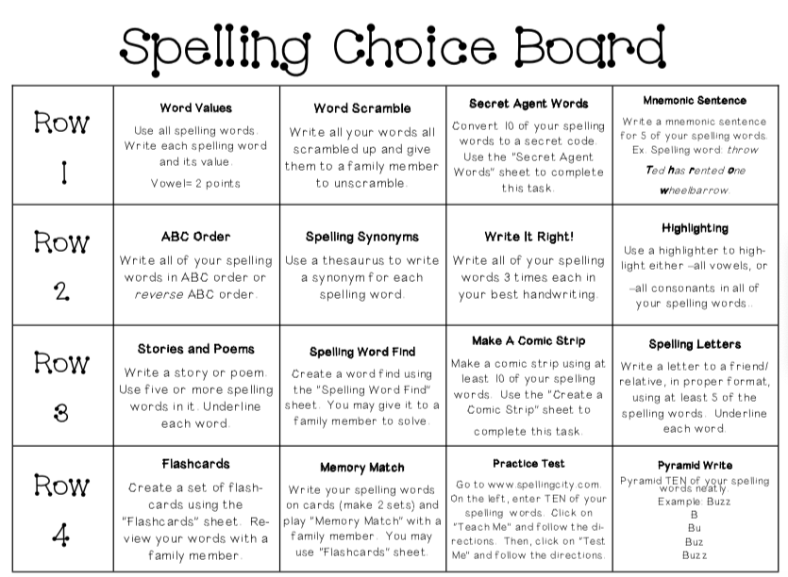
Spelling (20 minutes)
Look Cover Write Check your words. Complete an activity from the Spelling Choice Board.

Slide 5
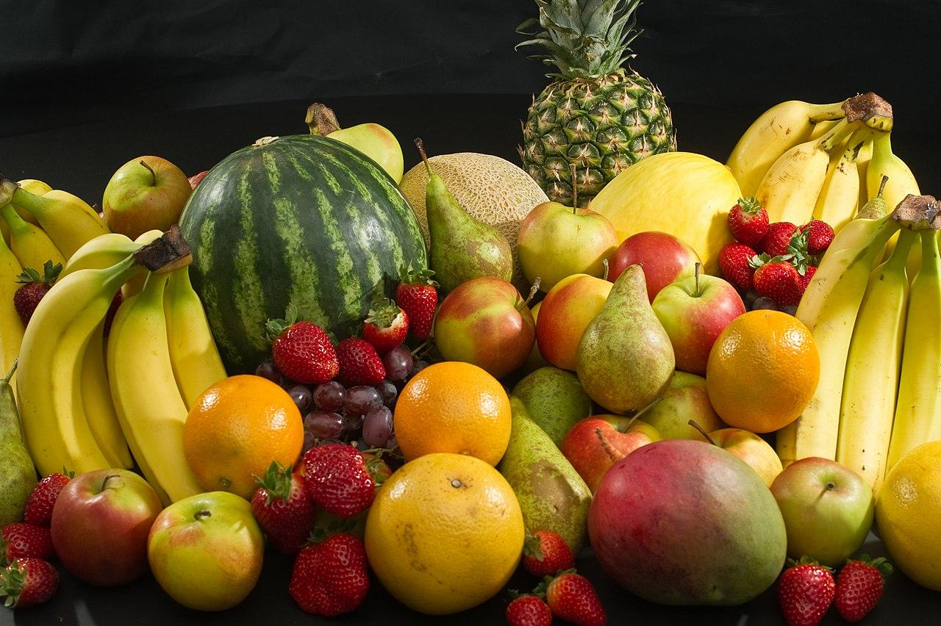
Fruit Break/ Brain Break:
Grab a piece of fruit or have a 10 minute break to go outside reset, refresh and restart.

Slide 6
Read works and Read Theory
Complete the reading passage and comprehension questions that have been provided by your class teacher in the google classroom.
This should take you 40-45 minutes to complete.

Slide 7
Read works/Read theory Link:

Slide 9
Writing - Editing
Rewrite the passage making the corrections listed at the bottom of the slide.

Slide 10
Writing: Descriptive
You have 40 minutes to write.
Click here: Tudor Children Facts | Tudor Childhood | DK Find Out

Slide 11
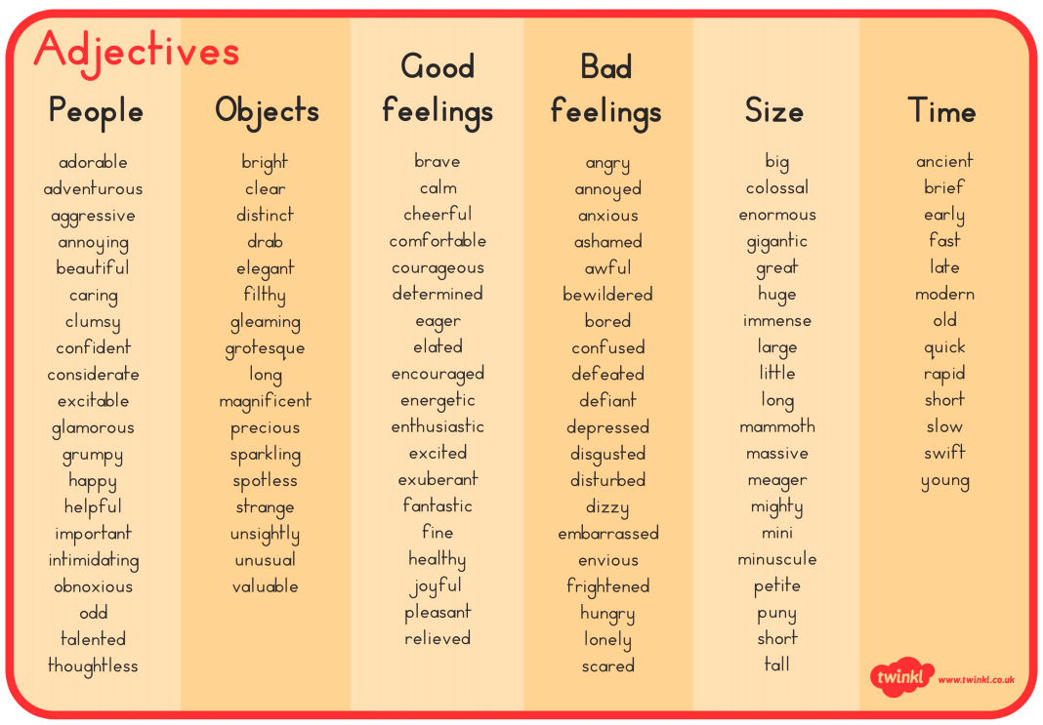

Slide 12
PUBLIC SPEAKING NEWS
Notes were handed out at the end of TERM 2. THE MAIN POINTS WERE
In STAGE 3
Prepared speeches should go for 4 mins
Stage Three students should state their point of view and then be encouraged to link their ideas to an issue or problem in society.
They should be linking ideas to other people and the world in general for their entire speech.
Give the audience a reason to care
Practice good eye contact and voice projection
Make sure your speech has a clear beginning, middle and end.
You can choose on of the topics below or YOUR OWN FREE CHOICE
THE TOPICS ARE
* My future career
*I’m inspired by ....... because
*If I could have a superpower, it would be….
Keep working on your speech for the Public Speaking Competition. When we do return to school we plan to go ahead with the speeches.
The finals may happen in the live stream format just like last year.
So keep working on your speech as it is part of your speaking and listening program for Term 3 and it will be assessed when we go back to school.

Slide 13
Handwriting/ Typing :
As part of the curriculum we need to learn how to effectively type and use digital technologies. Google Typing Club and take their placement test then complete one or more of the lessons. This should take 20 -30 minutes.
https://www.typingclub.com/

Slide 14
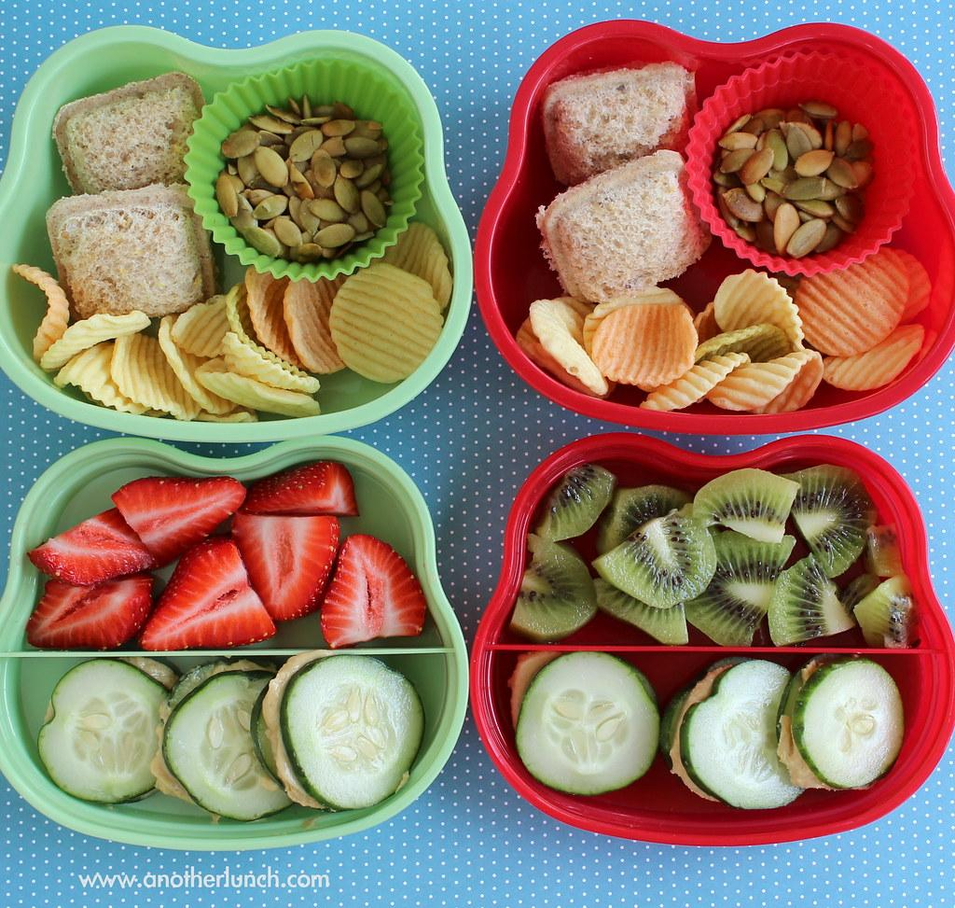
Lunch break-Break 1
Enjoy the 30 minute lunch break with your family.
Try to eat something healthy and drink some water.

Slide 15
Middle session
Numeracy: Numeracy Ninjas
Week 2 : Session 2

Slide 16
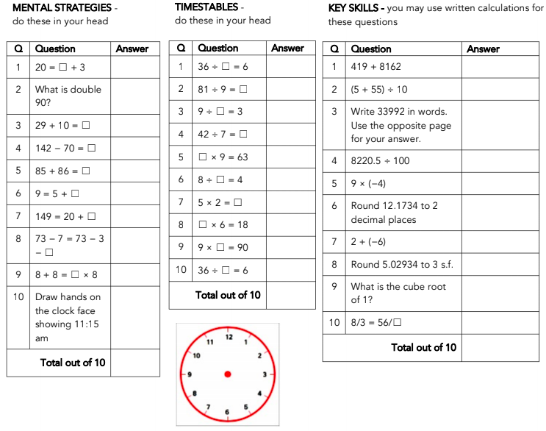
Numeracy Ninjas: Complete the questions below you have 5 -10 minutes

Slide 17
Numeracy Ninjas: Mark your work

Slide 18
Numeracy Ninjas: See which Ninja belt you have earned

Slide 19
Maths -Fractions
I am learning to:
Understand Fractional Language
Estimate Fractions
Compare Fractions
Fractions
Fractions on a number line and comparing fractions
What is a fraction?
A fraction is part of a whole number.
We can order and compare fractions by placing them on a ‘number line’
Any number can be placed on a number line, including fractions.
One way to position a fraction on the number line is to imagine or draw a shaded shape.

Slide 20
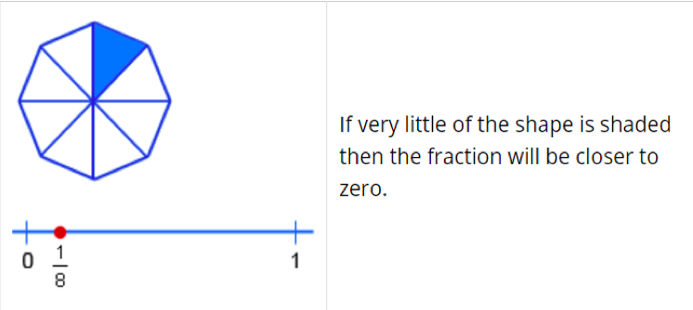
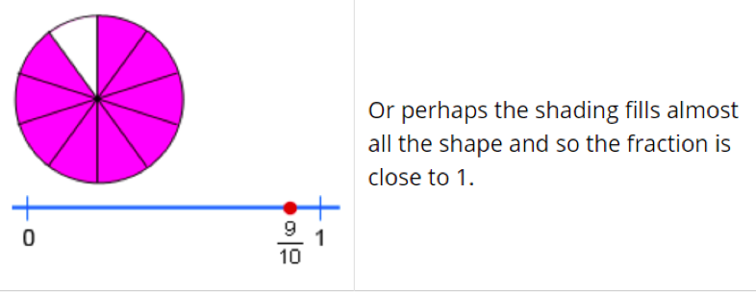
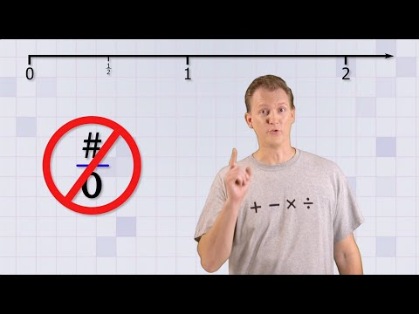
Maths -Fractions
I am learning to:
Understand Fractional Language
Estimate Fractions
Compare Fractions

Slide 21
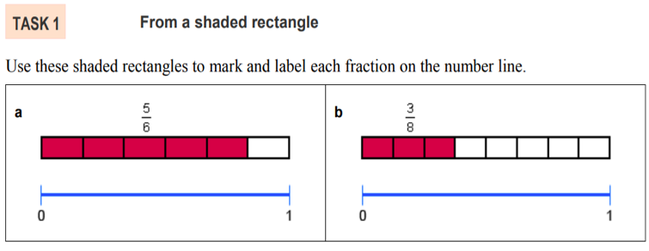
Maths -Fractions
I am learning to:
Understand Fractional Language
Estimate Fractions
Compare Fractions
Have a go with Task 1!

Slide 22
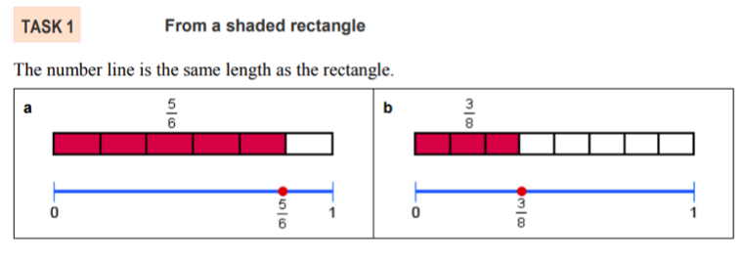
Maths -Fractions
I am learning to:
Understand Fractional Language
Estimate Fractions
Compare Fractions
Check if you got task 1 correctly

Slide 23
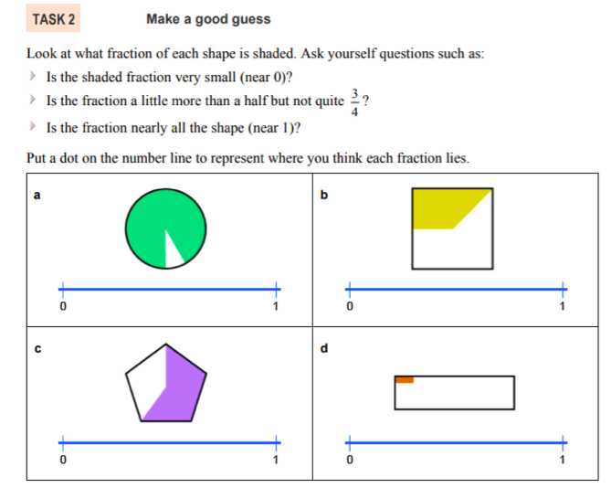
Maths -Fractions
I am learning to:
Understand Fractional Language
Estimate Fractions
Compare Fractions
Complete the task in your books.

Slide 24
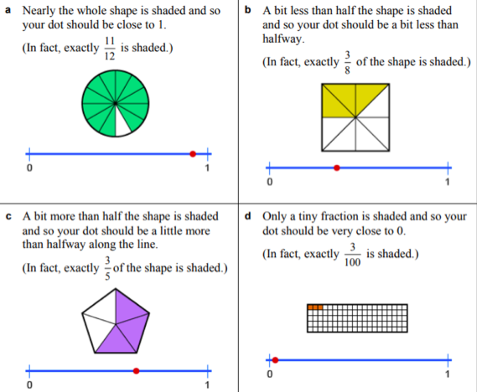
Maths -Fractions
I am learning to:
Understand Fractional Language
Estimate Fractions
Compare Fractions

Slide 25
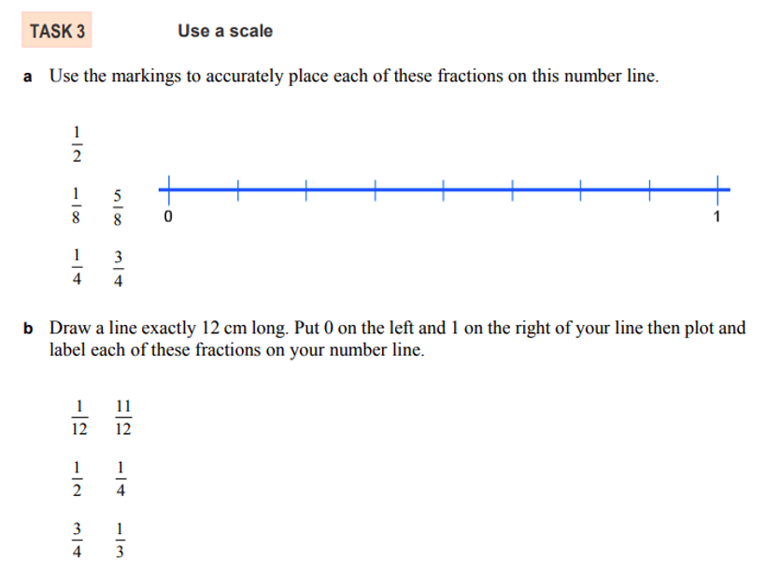
Maths -Fractions
I am learning to:
Understand Fractional Language
Estimate Fractions
Compare Fractions
Complete the task in your books.

Slide 26
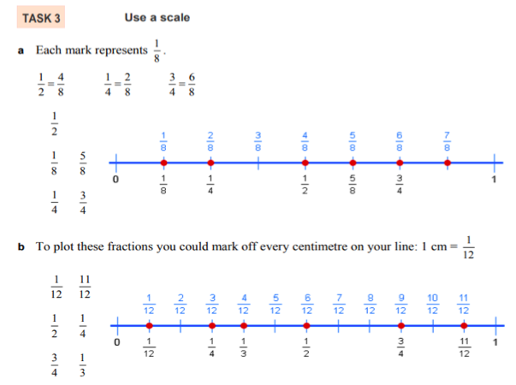
Maths -Fractions
I am learning to:
Understand Fractional Language
Estimate Fractions
Compare Fractions

Slide 27
Brain Break:
Go outside and lie on the ground look up at the clouds.
See if you can make some pictures with the clouds as they are moving.
Give yourself 5 minutes to do this task.

Slide 28
Matific
Extension and Fast Finisher
Go to https://www.matific.com/au/en-au/login-page/
Complete tasks on matific

Slide 29
Break 2: 30 minutes
Go outside.
Take this opportunity to run around outdoors.
Recharge and have a quick bite to eat so that you don’t become tired and irritable while you are sitting and working.
Drink plenty of water as well.

Slide 30
History - The Australian Colonies
Use the Padlet link below to access your class KWL chart about Australian Colonies. This is an interactive way for you to see what the rest of your peers are contributing throughout the term.
INSERT YOUR CLASS LINK HERE! https://padlet.com/ (this is just the website url)
What I KNOW (first column) - write down everything you know about the topic (think back to the Bathurst excursion)
What I WANT To Know (second column) - write down all the questions you have about Australian Colonies
What I LEARNED (third column) - contribute when you learn something new about the topic

Slide 31
Key Inquiry Question:
How did an Australian colony develop over time and why?
Watch the BTN videos ‘Endevaour History’ https://www.abc.net.au/btn/classroom/endeavour-history/12176470 & ‘Indigenous Perspectives of Cook Visit’ and note take key points that help you answer the key inquiry question. https://www.abc.net.au/btn/classroom/indigenous-perspectives-of-cook-visit/12176674
Afterwards, read through the Australian Colonies text on the next four slides and answer the following questions:
What does the term indigenous people mean?
Claims to the land by the indigenous people of colonised countries were often ignored. Was this fair? Explain your answer.
Even though Captain Cook sighted and met some Aboriginal people, he described the newly claimed colony of New South Wales as being terra nullius; a land belonging to nobody. Why do you think this is?

Slide 36
Key Inquiry Question:
How did an Australian colony develop over time and why?
Read the text on the next slide to learn more about why colonies were established in Australia.
Then answer the following questions:
Why do you think the powerful European nations, such as Spain, France and Britain, colonised other parts of the world?
What do you think was the primary reason Britain chose to colonise Australia?
The answers are not in the text so you’ll need to use your HEAD.

