Slide 1
Stage 3 Term 3 - Week 7
Tuesday 24th of August 2021

Slide 2
Week 7 Spelling Lists
Look Cover Write check your spelling words in your book.
Record your list words using red for the consonants and blue for the vowels.
Then complete an activity from the spelling choice board.

Slide 3
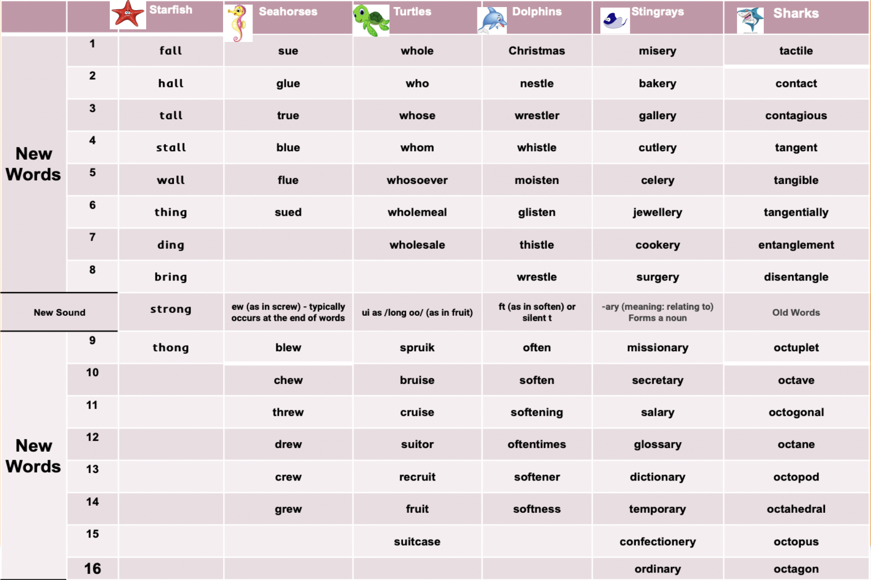
Week 7 Words

Slide 4
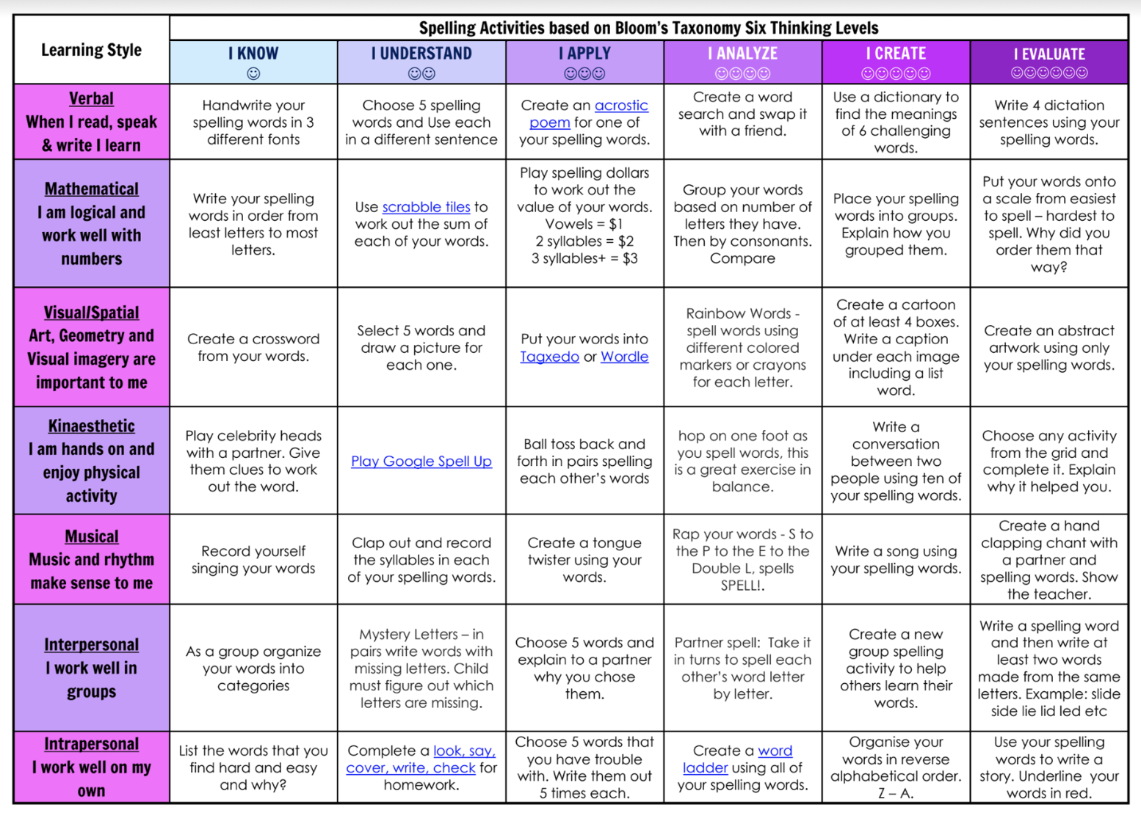
Spelling (20 minutes) - Look Cover Say Write Check your words. Complete an activity from the Spelling Choice Board.

Slide 5
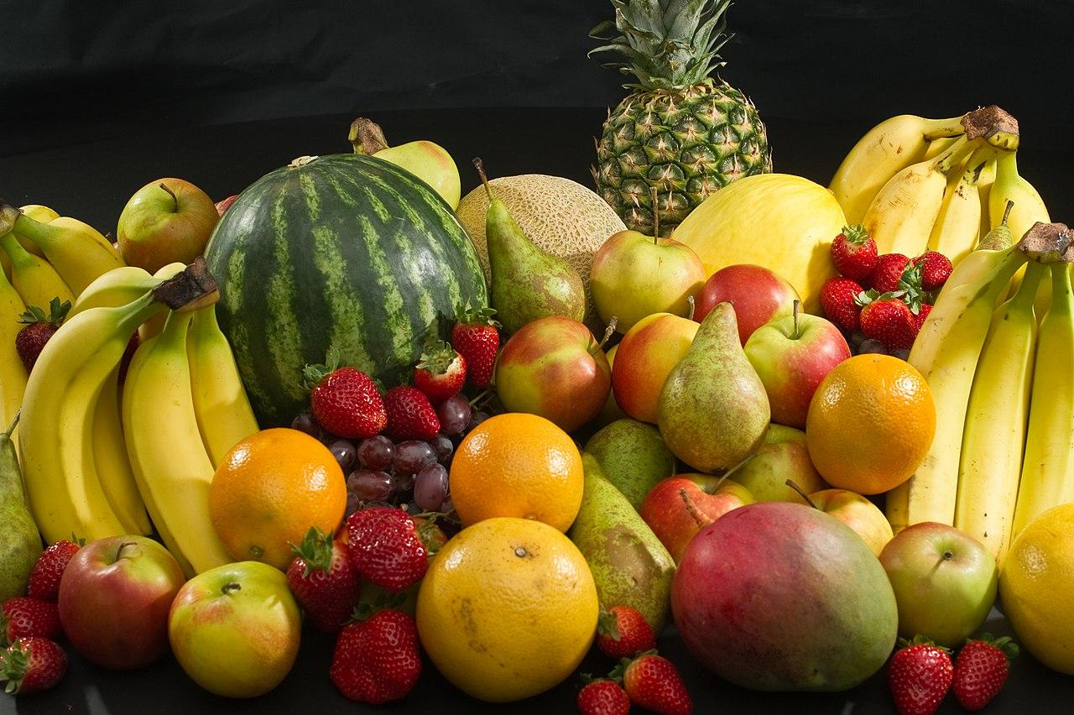
Fruit Break/ Brain Break:
Grab a piece of fruit or have a 10 minute break to go outside reset, refresh and restart.

Slide 6
Read works and Read Theory
Complete the reading passage and comprehension questions that have been provided by your class teacher in the google classroom.
This should take you 40-45 minutes to complete.

Slide 8
Learning Support
If you are working with Ms Carrington, Mrs Waggie or Mrs McCormick in Term 3, you will find your work in the Learning Support Google Classroom.
Everyone else, please go to the next slide.

Slide 9
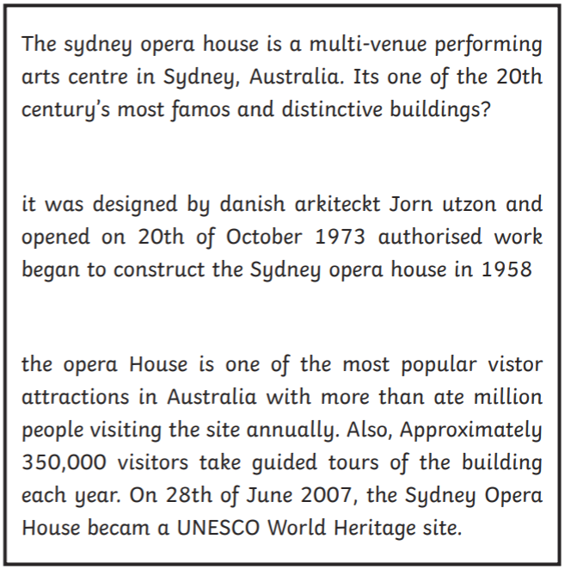
EDITING
Rewrite the passage making the corrections required.

Slide 10
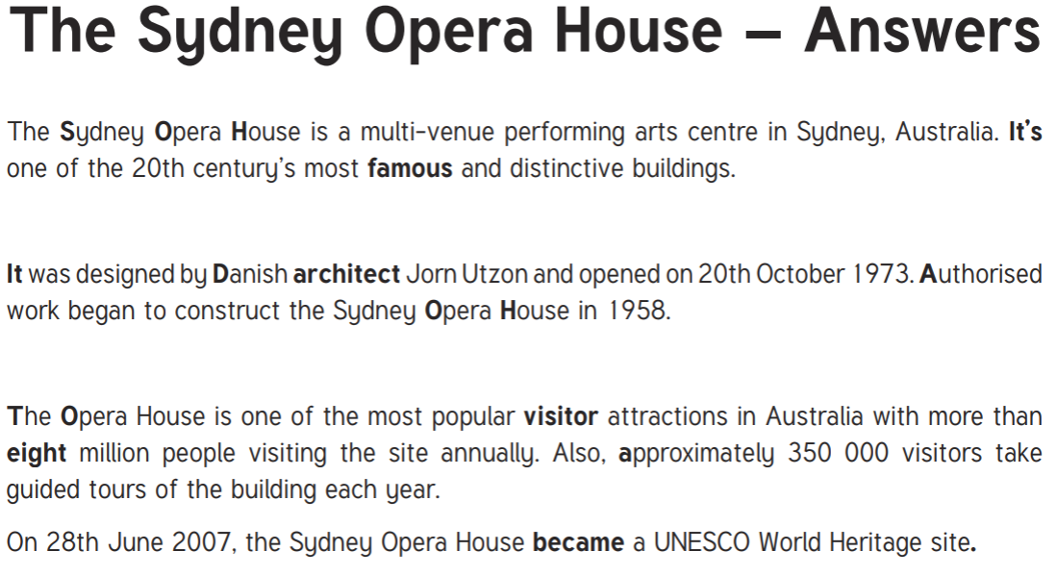

Slide 11
Let’s look at this in detail using our J.K Rowling example.

Slide 12
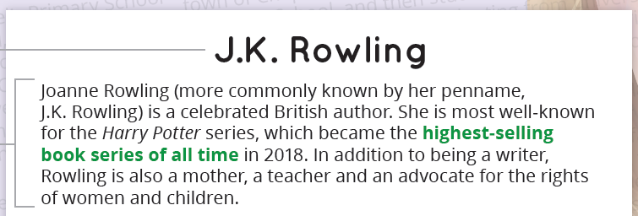
Biography
Introduction / Orientation
The biography begins with an orientation that introduces the person and explains why they are a celebrated person.
It includes attention grabbing details of the person’s life that make the audience want to read on.

Slide 13
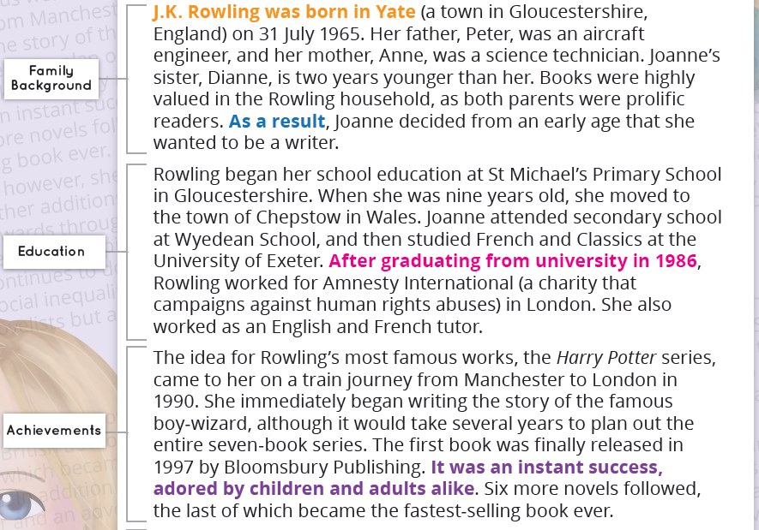
Biography
Key Events
The biography contains a series of paragraphs that describe the key life events of the person in chronological order.
Key events include their date and place of birth (and death, if applicable), early life family, home, education and influences that help the audience understand the person.
It gives specific details about people, places, events, dates and times.
It describes how these experiences helped to shape the person they became.

Slide 14
Biography
Summary
The biography ends with a summary that restates the person’s importance and their contribution to society.
It includes what they are doing now, or how they will be remembered.

Slide 15
Biography - Let’s review
Answer the following questions to check your understanding:
What is the purpose of a biography?
How are biographies generally structured?
What information should be included in the introduction/orientation of a biography?
What information should be included in the key events section of the a biography?
What information should be included in the summary of a biography?

Slide 16
Biography - Let’s review
Answer the following questions to check your understanding:
What is the purpose of a biography?
To retell the events, experiences and achievements of a person's life.
How are biographies generally structured?
Biographies have a title, introduction/orientation, a series of key events, and a summary.
What information should be included in the introduction/orientation of a biography?
An introduction to the person and an explanation of why they are a celebrated person.
What information should be included in the key events section of the a biography?
Key events including the person’s date and place of birth (and death, if applicable), early life family, home, education and influences that help the audience understand the person.
What information should be included in the summary of a biography?
It should restate the person’s importance, their contribution to society, and what they are doing now, or how they will be remembered.

Slide 17
PUBLIC SPEAKING NEWS
Notes were handed out at the end of TERM 2. THE MAIN POINTS WERE
In STAGE 3
Prepared speeches should go for 4 mins
Stage Three students should state their point of view and then be encouraged to link their ideas to an issue or problem in society.
They should be linking ideas to other people and the world in general for their entire speech.
Give the audience a reason to care
Practice good eye contact and voice projection
Make sure your speech has a clear beginning, middle and end.
You can choose on of the topics below or YOUR OWN FREE CHOICE
THE TOPICS ARE
* My future career
*I’m inspired by ....... because
*If I could have a superpower, it would be….
Keep working on your speech for the Public Speaking Competition. When we do return to school we plan to go ahead with the speeches.
The finals may happen in the live stream format just like last year.
So keep working on your speech as it is part of your speaking and listening program for Term 3 and it will be assessed when we go back to school.

Slide 18
Handwriting/ Typing :
As part of the curriculum we need to learn how to effectively type and use digital technologies. Google Typing Club and take their placement test then complete one or more of the lessons. This should take 20 -30 minutes.

Slide 19
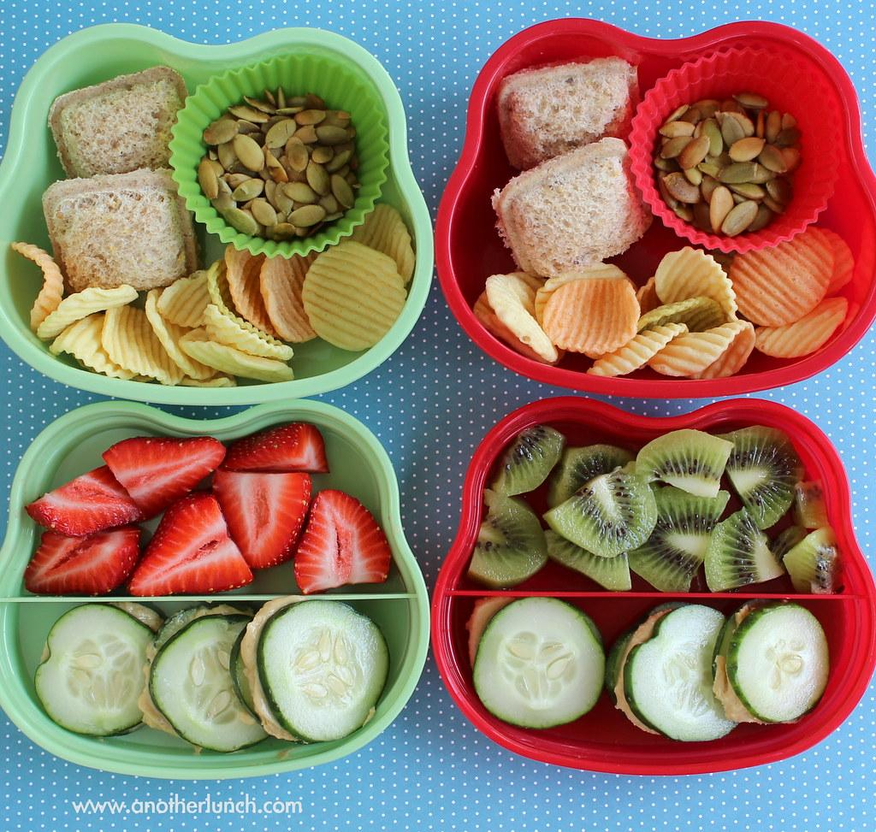
Lunch break-Break 1
Enjoy the 30 minute lunch break with your family.
Try to eat something healthy and drink some water.

Slide 20
Middle Session
Numeracy: Numeracy Ninjas
Week 7 : Session 2

Slide 21
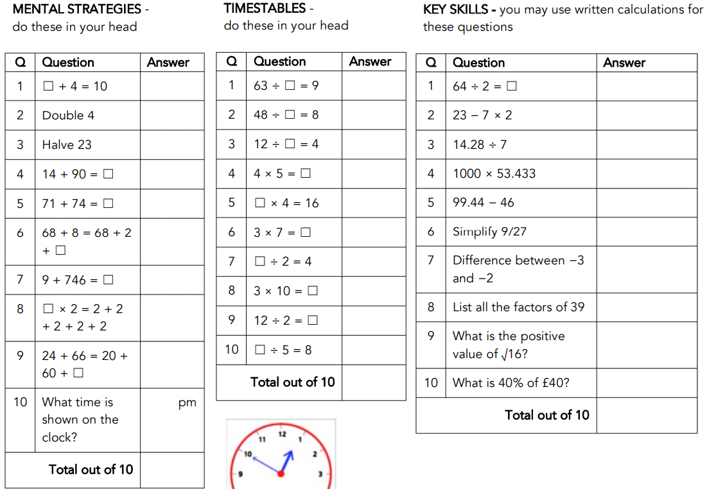
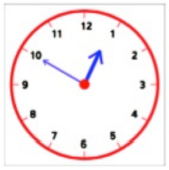
Numeracy Ninjas:
Complete the questions you have 5 -10 minutes
Numeracy Ninjas Week 17 Session 2

Slide 22
Numeracy Ninjas: ANSWERS
Mental Strategies
Timestables
Q | Question | Answer
1 | ☐ + 4 = 10 | 6
2 | Double 4 | 8
3 | Halve 23 | 11.5
4 | 14 + 90 = ☐ | 104
5 | 71 + 74 = ☐ | 145
6 | 68 + 8 = 68 + 2 + ☐ | 6
7 | 9 + 746 = ☐ | 755
8 | ☐ × 2 = 2 + 2 + 2 + 2 + 2 | 5
9 | 24 + 66 = 20 + 60 + ☐ | 10
10 | What time is shown on the clock? | 12:50 pm
Q | Question | Answer
1 | 63 ÷ ☐ = 9 | 7
2 | 48 ÷ ☐ = 8 | 6
3 | 12 ÷ ☐ = 4 | 3
4 | 4 × 5 = ☐ | 20
5 | ☐ × 4 = 16 | 4
6 | 3 × 7 = ☐ | 21
7 | ☐ ÷ 2 = 4 | 8
8 | 3 × 10 = ☐ | 30
9 | 12 ÷ 2 = ☐ | 6
10 | ☐ ÷ 5 = 8 | 40
Numeracy Ninjas Week 17 Session 2
Notes:
Week 17 Session 1
Mental Strategies Answers

Slide 23
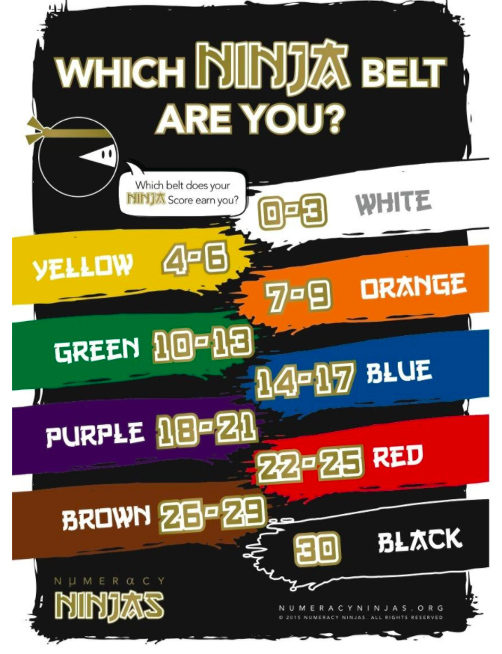
Numeracy Ninjas - Check your answers...
Key Skills
Q | Question | Answer
1 | 64 ÷ 2 = ☐ | 32
2 | 23 − 7 × 2 | 9
3 | 14.28 ÷ 7 | 2.04
4 | 1000 × 53.433 | 53433
5 | 99.44 − 46 | 53.44
6 | Simplify 9/27 | 1/3
7 | Difference between −3 and −2 | 1
8 | List all the factors of 39 | 1, 3, 13, 39
9 | What is the positive value of √16? | 4
10 | What is 40% of £40? | £16

Slide 24
Maths - Multiplying decimals by 1 digit numbers
I am learning to: use written and mental strategies to multiply simple decimals by single-digit numbers
Decimal multiplication is like whole number multiplication. The rules for multiplying a decimal by a whole number are:
In the multiplication of a decimal number by a whole number, we first multiply the numbers by ignoring the decimal point. For example the expression 0.3 x 9 becomes 3 x 9 which equals = 27
We then put the decimal point before as many places in the product as there are in the decimal number The decimal point in 0.3 is 1 space from the right, so the decimal point in our answer 27 must be one space from the right 2.7
Therefore the answer to 0.3 x 9 = 2.7

Slide 25
Maths - Multiplying decimals by 1 digit numbers
I am learning to: use written and mental strategies to multiply simple decimals by single-digit numbers
Follow the steps below to try the following example: 0.8 x 6 =

Slide 26
Maths - Multiplying decimals by 1 digit numbers
I am learning to: use written and mental strategies to multiply simple decimals by single-digit numbers
Check your answer... 0.8 x 6 = 4.8
0.8 x 6 becomes 8 x 6
There is 1 decimal place in 0.8
8 x 6 = 48 Therefore 0.8 x 6 = 4.8

Slide 27
Maths - Multiplying decimals by 1 digit numbers
I am learning to: use written and mental strategies to multiply simple decimals by single-digit numbers
Use a mental strategy to answer the questions below…

Slide 28
Maths - Multiplying decimals by 1 digit numbers
I am learning to: use written and mental strategies to multiply simple decimals by single-digit numbers
Mark your answers...

Slide 29
Maths - Multiplying decimals by 1 digit numbers
I am learning to: use written and mental strategies to multiply simple decimals by single-digit numbers
Answer the multiplication questions using the grids below…
24
+
1.2
=
25.2
=
=
=
=
=

Slide 30
Maths - Multiplying decimals by 1-digit numbers
I am learning to: use written and mental strategies to multiply simple decimals by single-digit numbers
Mark you answers...
24
1.2
10
0.4
21
1.4
=
25.2
=
14
=
22.4
63
2.7
16
7.2
35
1.0
=
65.7
=
=
36
23.2

Slide 31
Maths reflection...
How confident do you feel multiplying decimals by 1-digit numbers? Complete the self assessment scale by choosing an answer below...
Very Confident,
Confident,
OK,
I Need Some Help,
I Have No Idea!

Slide 32
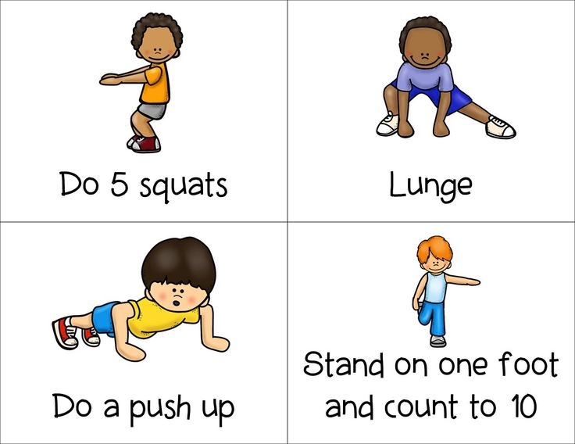
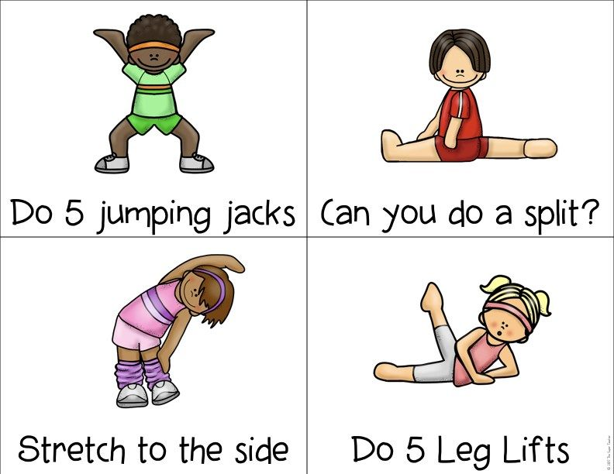
Brain Break:
Let’s rest our brains and stretch our bodies...

Slide 33
Matific
Extension and Fast Finisher
Go to https://www.matific.com/au/en-au/login-page/
Complete tasks on matific

Slide 34
Break 2: 30 minutes
Go outside.
Take this opportunity to run around outdoors.
Recharge and have a quick bite to eat so that you don’t become tired and irritable while you are sitting and working.
Drink plenty of water as well.

Slide 35
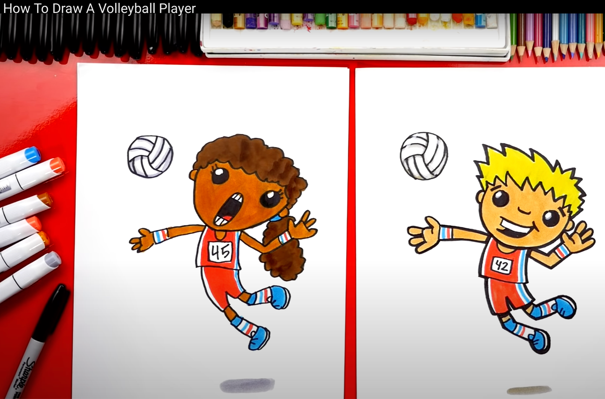
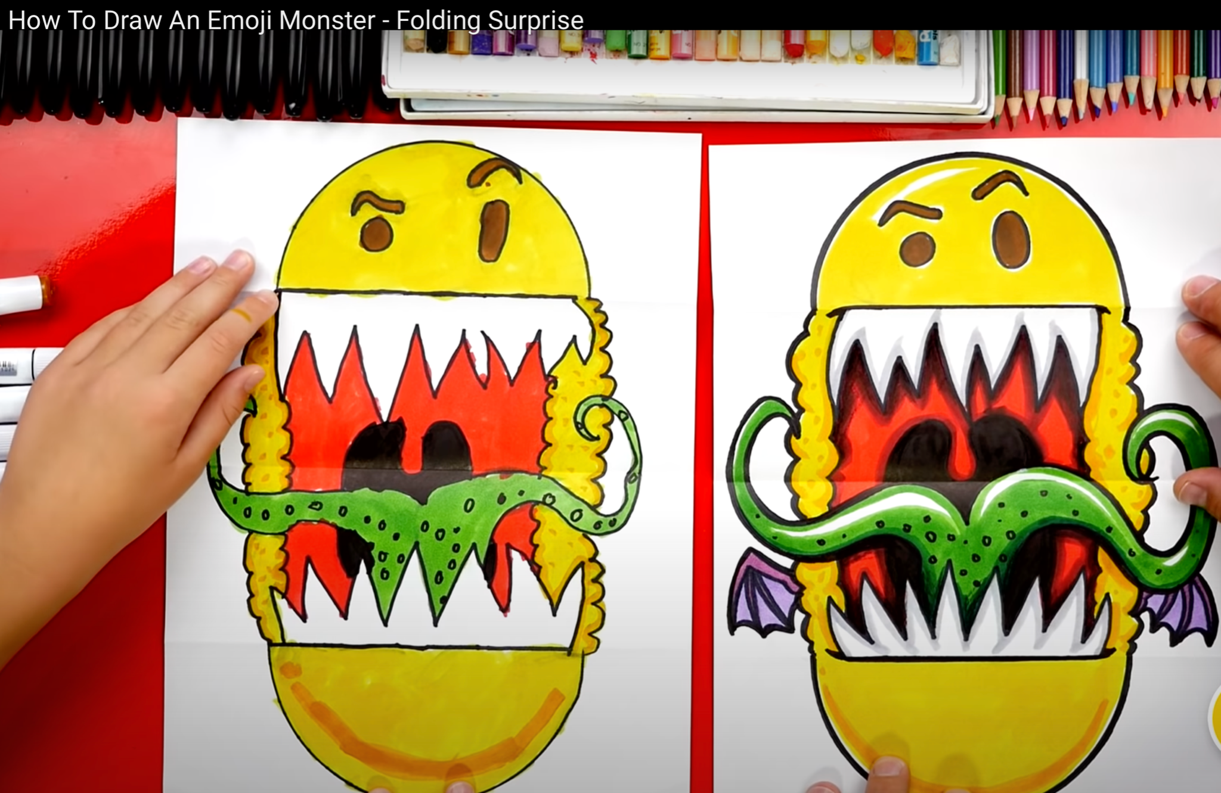
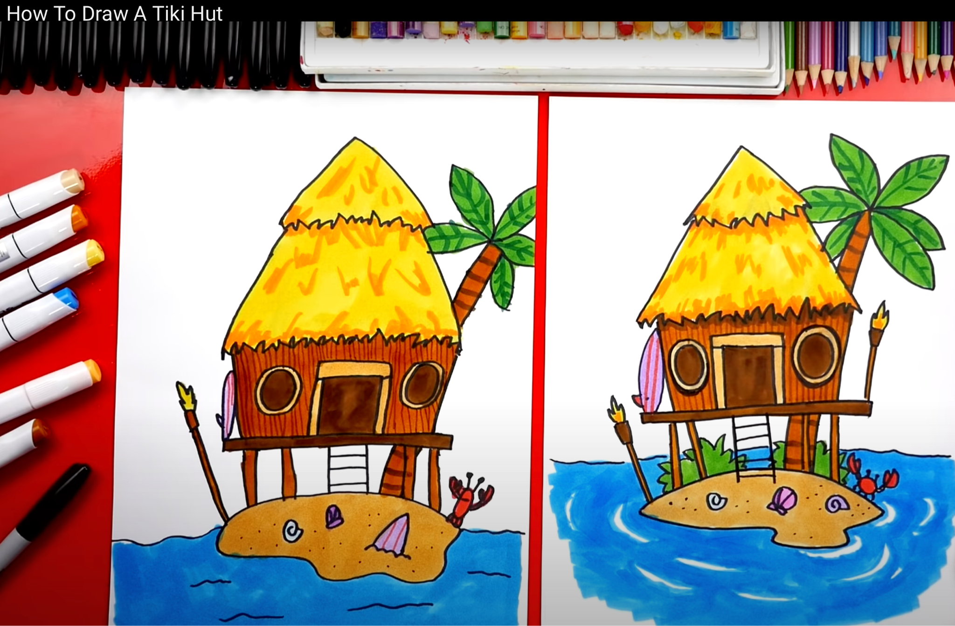
Visual Arts - Guided Drawing
Visit the ‘Arts for Kids Hub’ Youtube channel and choose one of the options below to draw https://www.youtube.com/c/ArtforKidsHub/videos
Option 1: Volleyball Player Option 2: Emoji Monster (folding surprise) Option 3: Tiki Hut
Once completed, identify the different art elements you have included in your drawing. Refer to the Elements of Art poster on the next slide. Don’t forget to share your amazing drawing with your teacher through Seesaw or Google Classroom.

Slide 37
Fast Finishers

