Slide 1
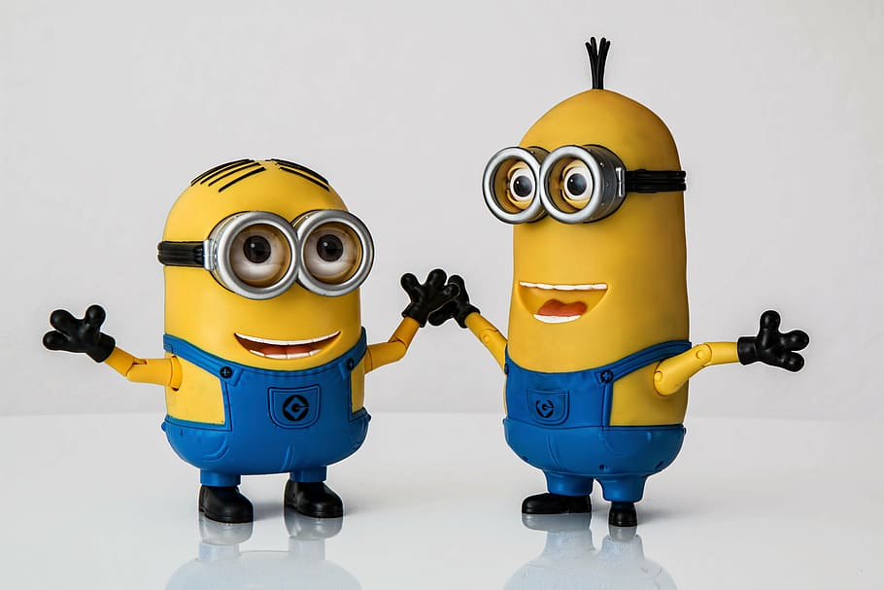
Stage 3 Term 3-Week 6
Thursday 19th of August 2021

Slide 2

Week 6 Spelling Lists
Look Cover Write check your spelling words in your book.
Record your list words using red for the consonants and blue for the vowels.
Then complete an activity from the spelling choice board.

Slide 3

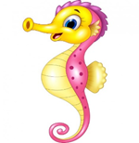




Week 6 Words
 |  | Starfish | Seahorses | Turtles | Dolphins | Stingrays | Sharks
OLD words | 1 | afraid | few | pour | folk | youngling | supervise
 | 2 | waist | spew | court | yolk | weakling | television
 | 3 | wail | knew | your | folklore | seedling | evidence
 | 4 | raid | stew | four | folks | hatchling | advise
 | 5 | bail | brew | fourth | yolky | trifling | visible
 | 6 |  | pew | fourteen |  | earthling | revise
 | 7 |  |  | poured |  | inkling | vision
 | 8 |  |  |  |  | changeling | revision
New Sound |  | “all “as in ball | ue (as in glue) typically occurs at the end of words | wh as /h/ (as in whole) | st (as in castle) or silent t | -ery (meaning: relating to) Forms a noun | Phonic Concept: tactus, tangent (meaning: to touch)
New Words | 9 | stall | sue | whole | listen | archery | tactile
 | 10 | wall | glue | who | whistle | stationery | contact
 | 11 | football | true | whose | moisten | grocery | contagious
 | 12 | hall | blue | whom | glisten | pottery | tangent
 | 13 | call | flue | whosoever | listening | delivery | tangible
 | 14 |  | sued | wholemeal | thistle | mystery | tangentially
 | 15 |  |  | wholesale | wrestle | lottery | entanglement
 | 16 |  |  |  | unfasten | joinery | disentangle

Slide 4
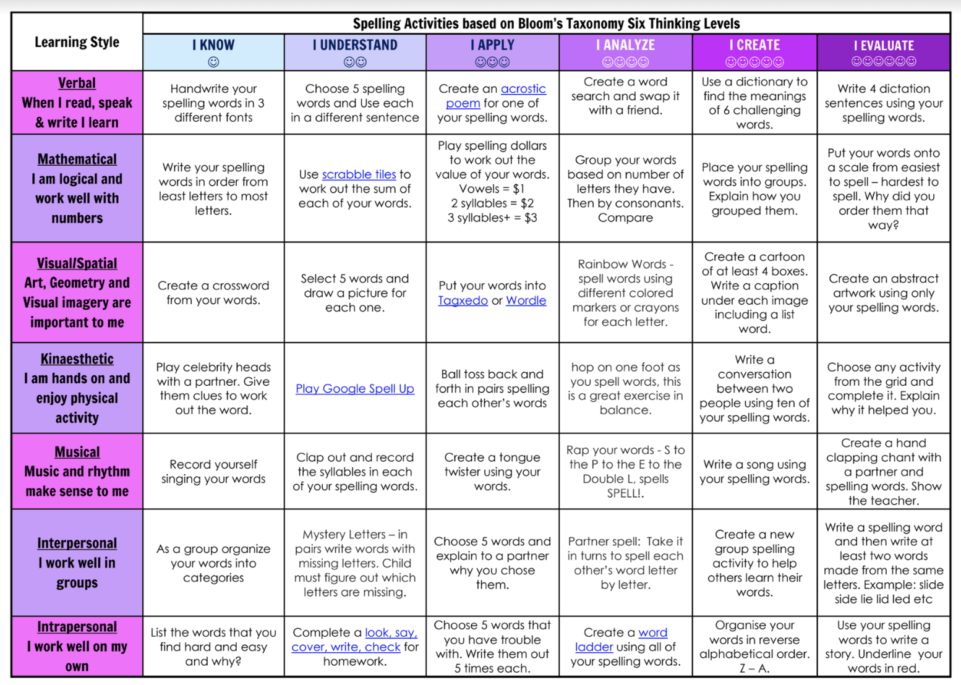
Spelling (20 minutes) - Look Cover Say Write Check your words. Complete an activity from the Spelling Choice Board.

Slide 5
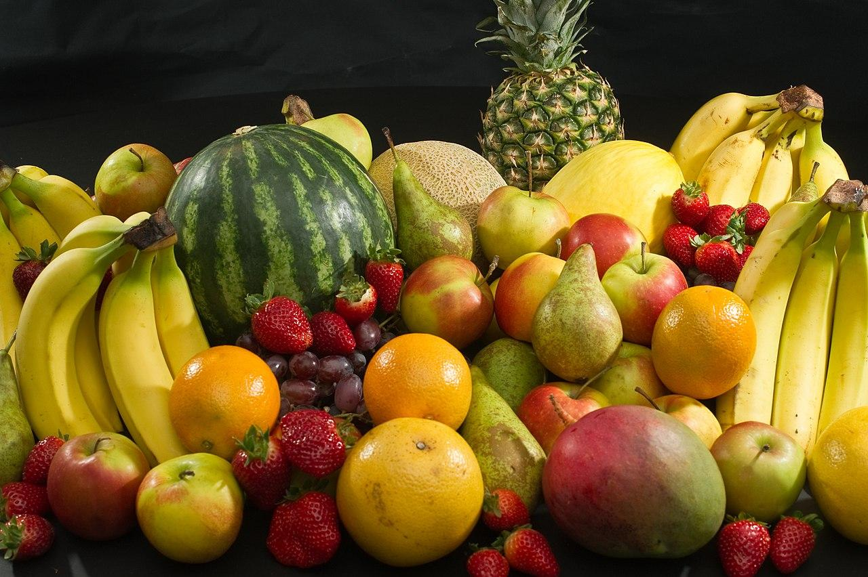


Fruit Break/ Brain Break:
Grab a piece of fruit or have a 10 minute break to go outside reset, refresh and restart.

Slide 6

Read works and Read Theory
Complete the reading passage and comprehension questions that have been provided by your class teacher in the google classroom.
This should take you 40-45 minutes to complete.

Slide 7
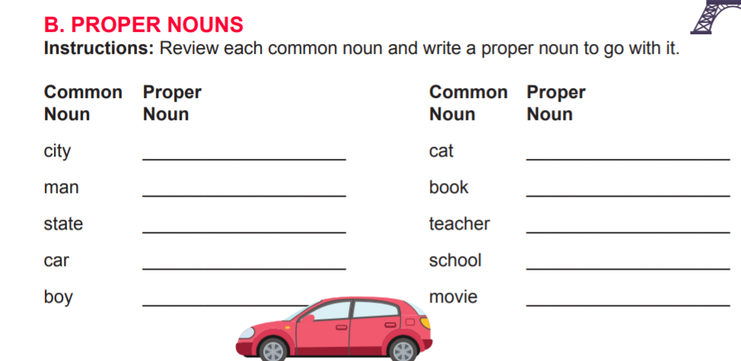
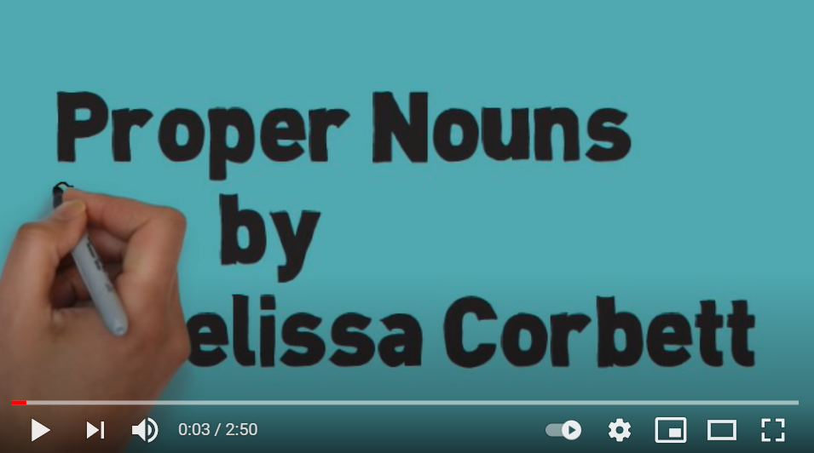
Grammar and Punctuation
Watch this clip about Proper Nouns.

Slide 8

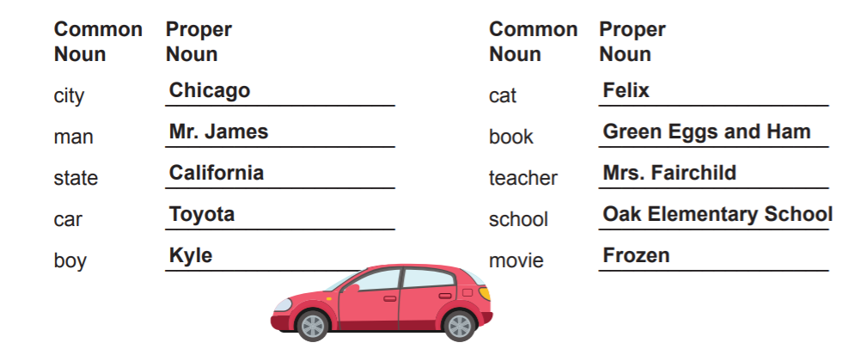
Your answers will vary from the ones below but they should look something like the following. Each word must start with a CAPITAL LETTER!

Slide 9


Learning Support
If you are working with Ms Carrington, Mrs Waggie or Mrs McCormick in Term 3, you will find your work in the Learning Support Google Classroom.
Everyone else, please go to the next slide.

Slide 10
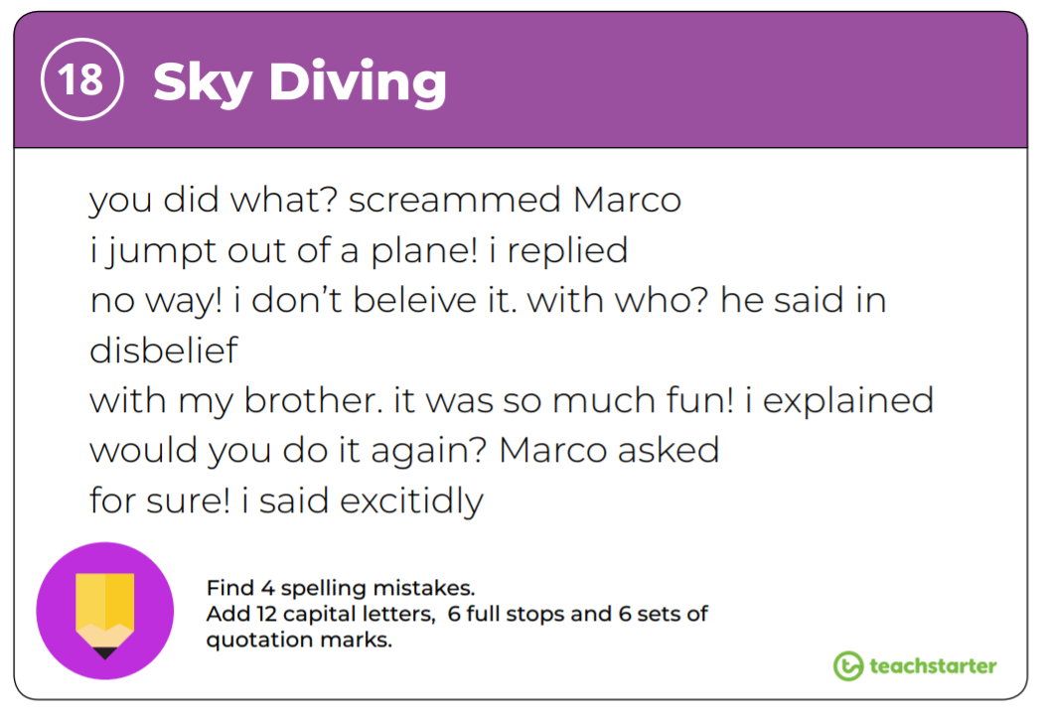
EDITING
Rewrite the passage making the corrections listed at the bottom of the slide.

Slide 11

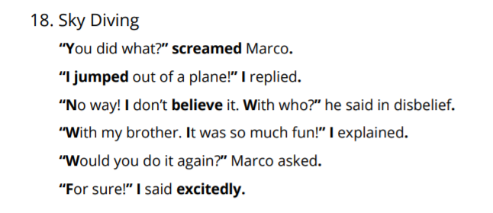


Slide 12
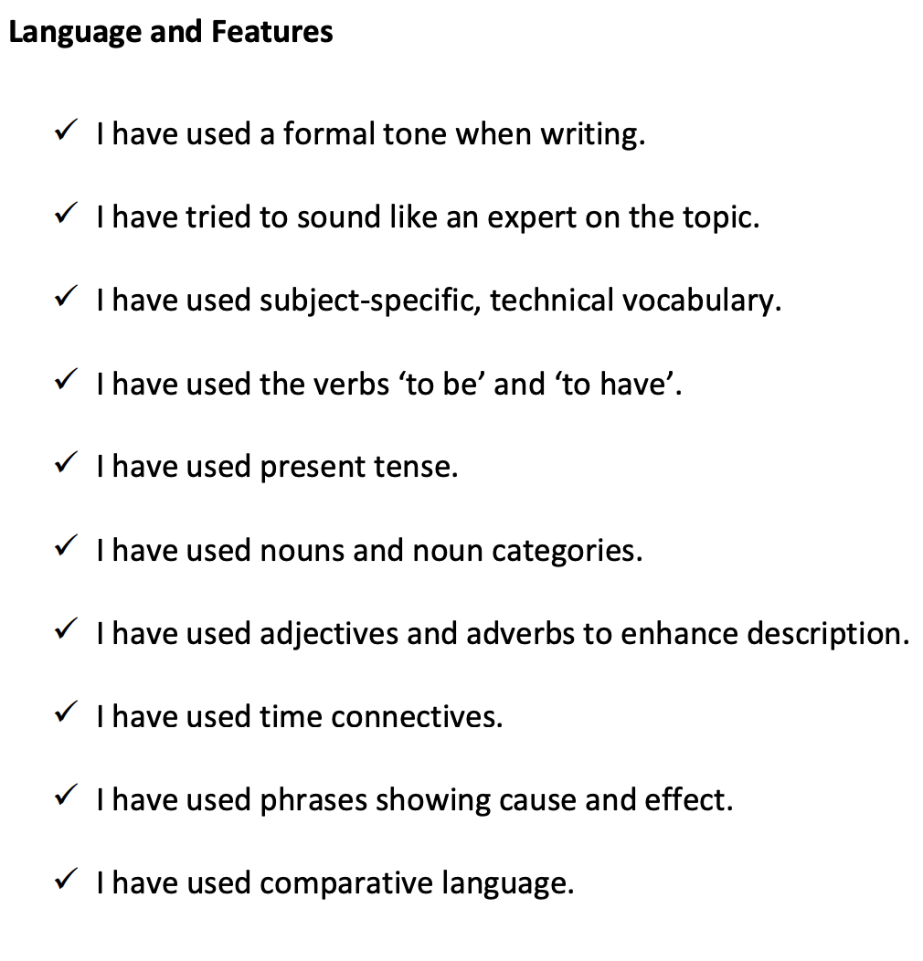
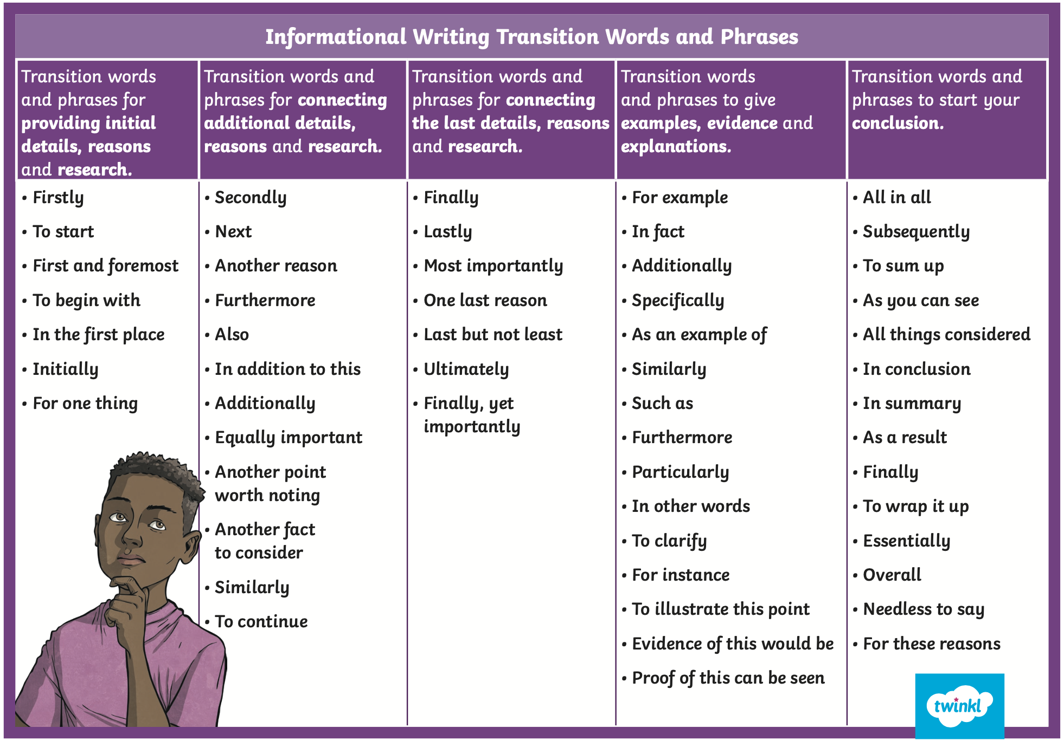
Informative Writing
Language Features

Slide 13

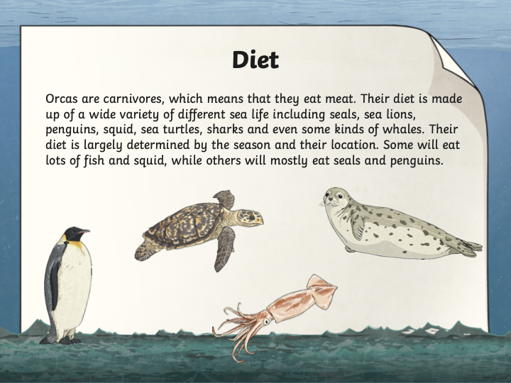
Here is some information about the diet of Orcas.
What technical words are used here? If there aren’t enough, can you include some?
Can you rewrite the information in your own words and include some more interesting information?
Can we include statistics and definitions to make our writing more interesting?
Is the information easy to understand?

Slide 14


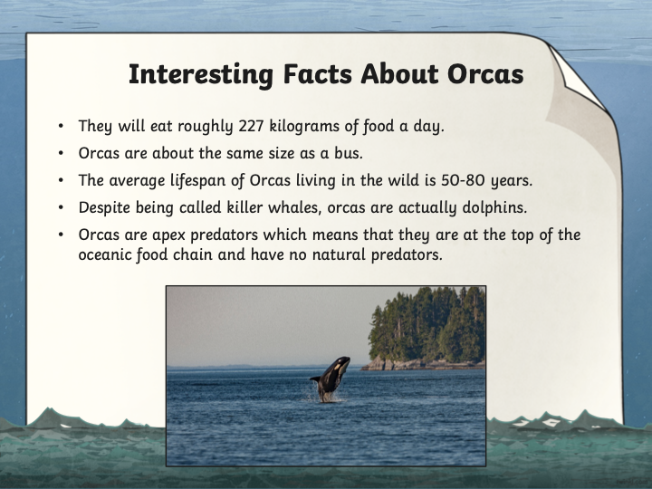
Here is some interesting information about Orcas.
Where can this information be used in your text?
Is it a good idea to have this information in a new paragraph or include it throughout your writing?
Is the information reliable? Has it come from a factual source? Is it in your own words?
Use the research/writing template on the next slide to do some research on an animal you find interesting.
Pick an animal you don’t know much about and ensure your answers are in your own words.

Slide 15
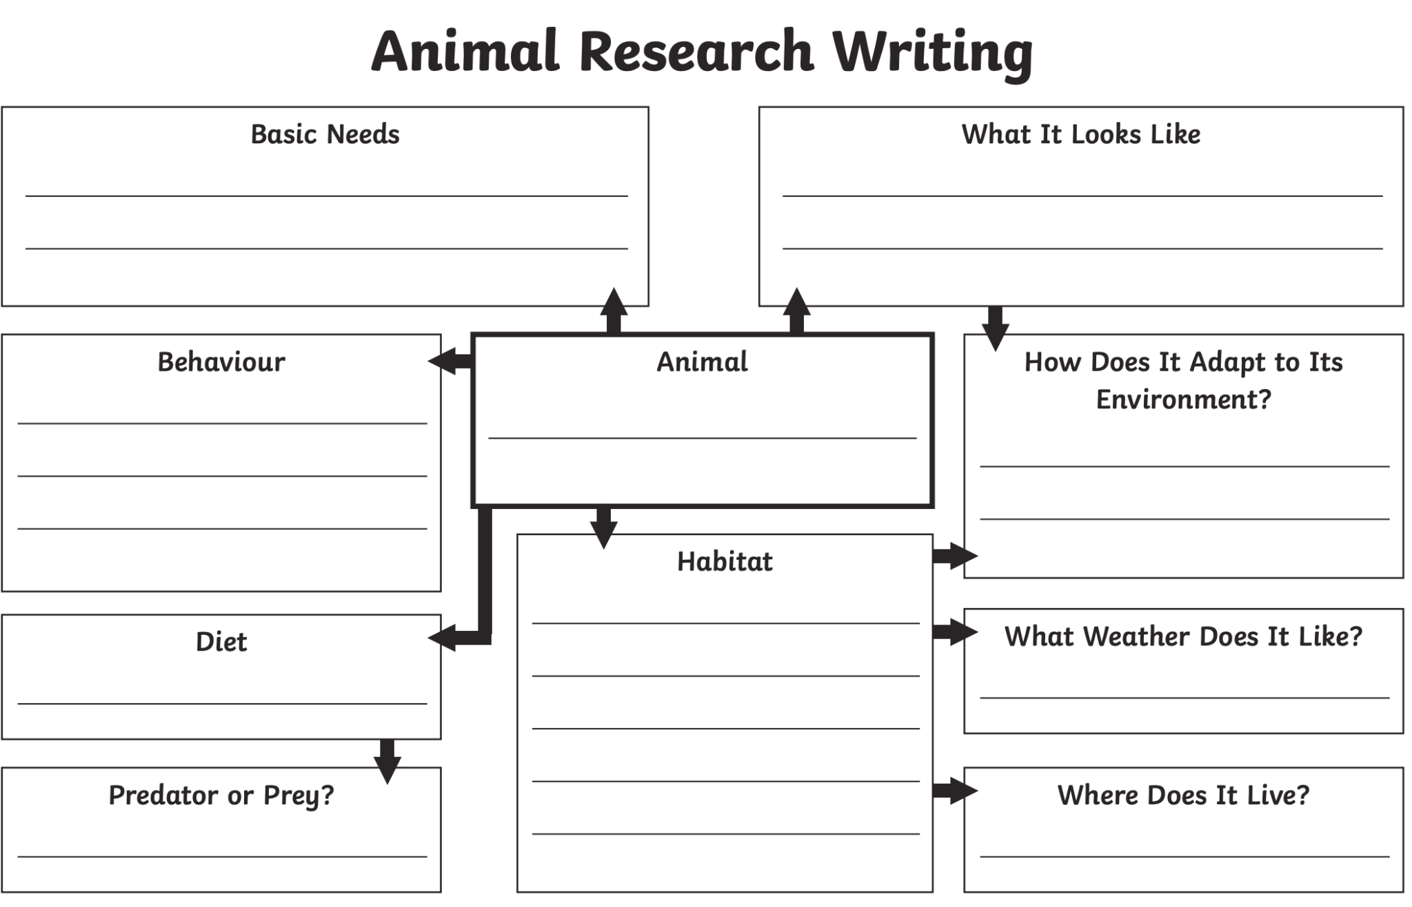
Technical vocab:
__________
__________
__________
__________
Statistics:
__________
__________
__________
__________
__________
__________

Slide 16
PUBLIC SPEAKING NEWS
Notes were handed out at the end of TERM 2. THE MAIN POINTS WERE
In STAGE 3
Prepared speeches should go for 4 mins
Stage Three students should state their point of view and then be encouraged to link their ideas to an issue or problem in society.
They should be linking ideas to other people and the world in general for their entire speech.
Give the audience a reason to care
Practice good eye contact and voice projection
Make sure your speech has a clear beginning, middle and end.
You can choose on of the topics below or YOUR OWN FREE CHOICE
THE TOPICS ARE
* My future career
*I’m inspired by ....... because
*If I could have a superpower, it would be….
Keep working on your speech for the Public Speaking Competition. When we do return to school we plan to go ahead with the speeches.
The finals may happen in the live stream format just like last year.
So keep working on your speech as it is part of your speaking and listening program for Term 3 and it will be assessed when we go back to school.

Slide 17

Handwriting/ Typing :
As part of the curriculum we need to learn how to effectively type and use digital technologies. Google Typing Club and take their placement test then complete one or more of the lessons. This should take 20 -30 minutes.

Slide 18

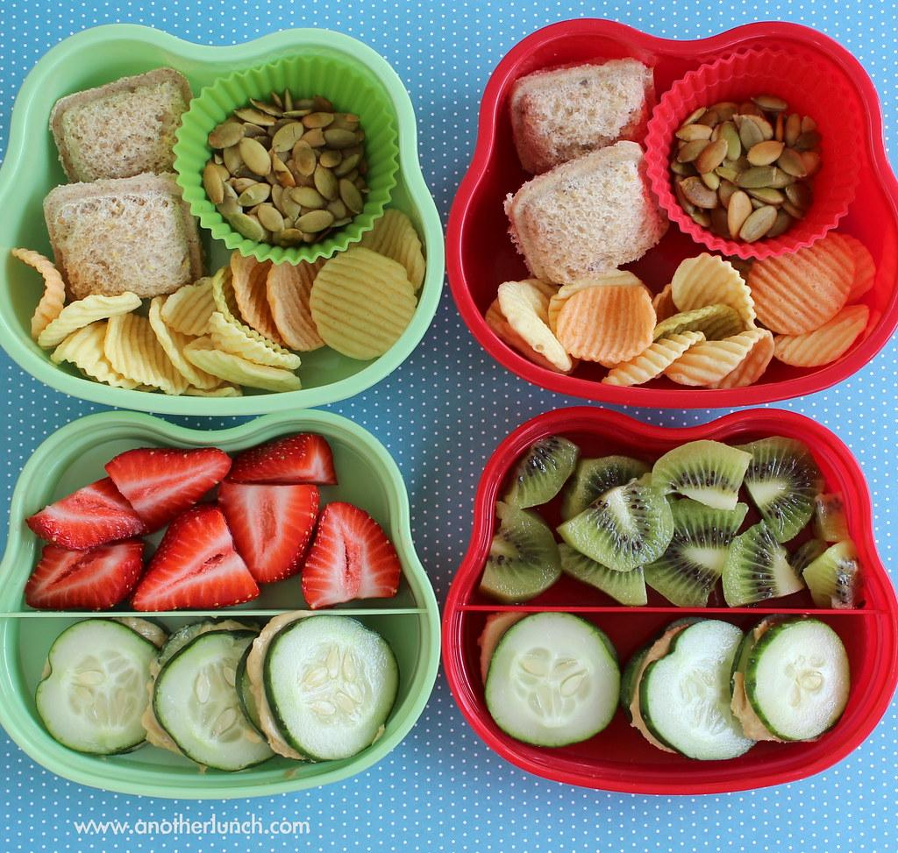
Lunch break-Break 1
Enjoy the 30 minute lunch break with your family.
Try to eat something healthy and drink some water.

Slide 19

Middle Session
Numeracy: Numeracy Ninjas
Week 6 Session 4

Slide 20
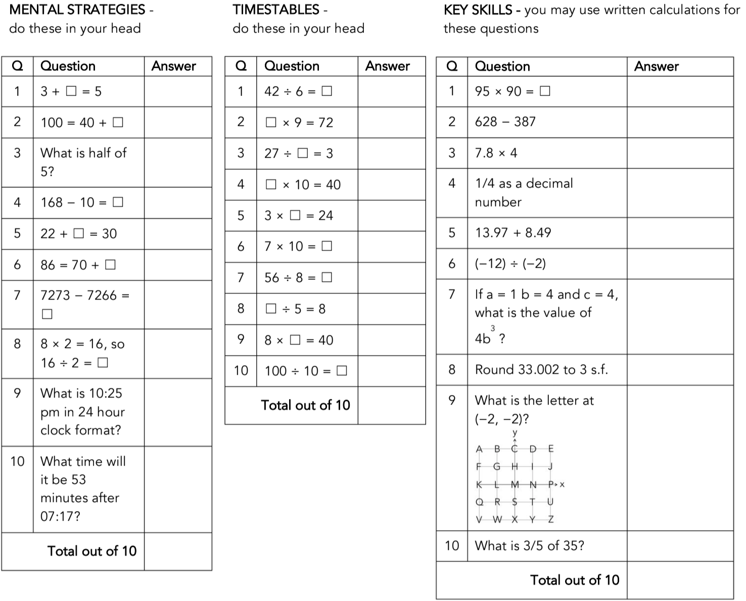
Numeracy Ninjas:
Complete the questions. You have 5 -10 minutes.
Numeracy Ninjas Week 16 Session 4

Slide 21
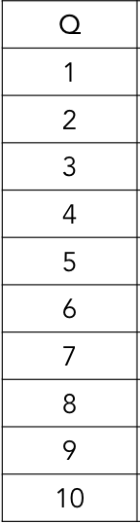
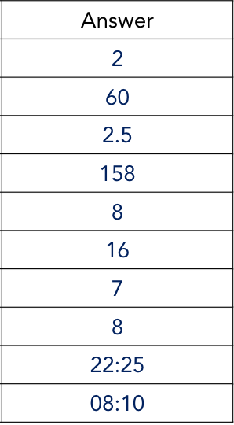
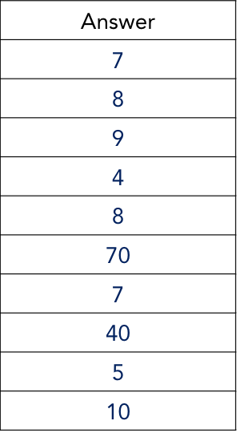
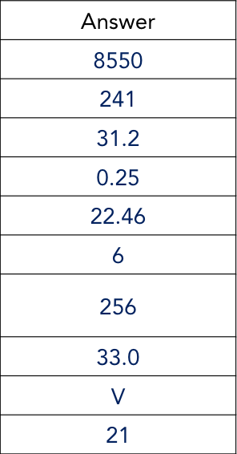
Numeracy Ninjas: ANSWERS
Numeracy Ninjas Week 16 Session 4
Mental Strategies Times Tables Key Skills

Slide 22
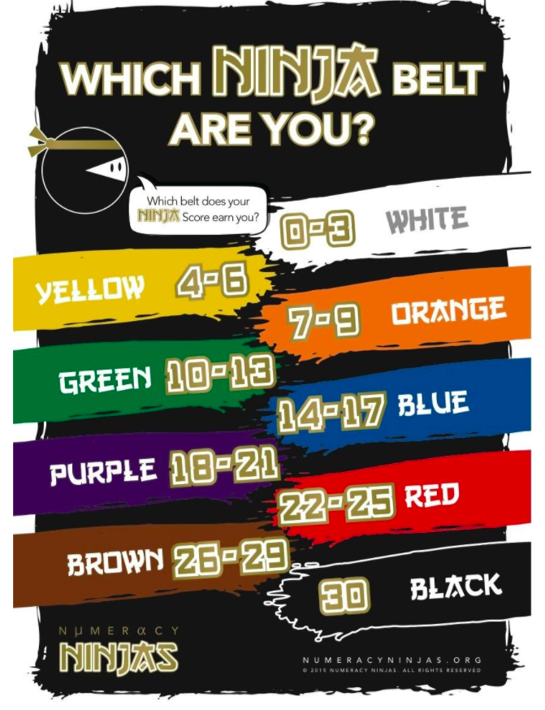

How did you go?

Slide 23

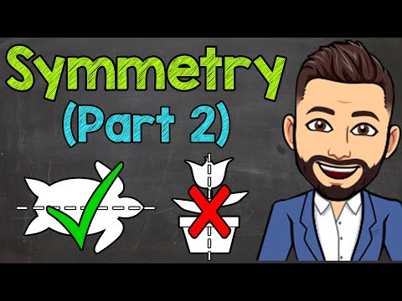
What is Symmetry?
I am learning to:
identify whether a two-dimensional shape has been translated, reflected or rotated
construct patterns of two-dimensional shapes that involve translations, reflections and rotations
predict the next translation, reflection or rotation in a pattern
Symmetry is when an object looks the exact same on one side as the other. To see if an object is symmetrical, you draw a line of symmetry or a line dividing an object to show a perfect match on each side. It's like making a mirror image. This is also known as reflectional symmetry.

Slide 24
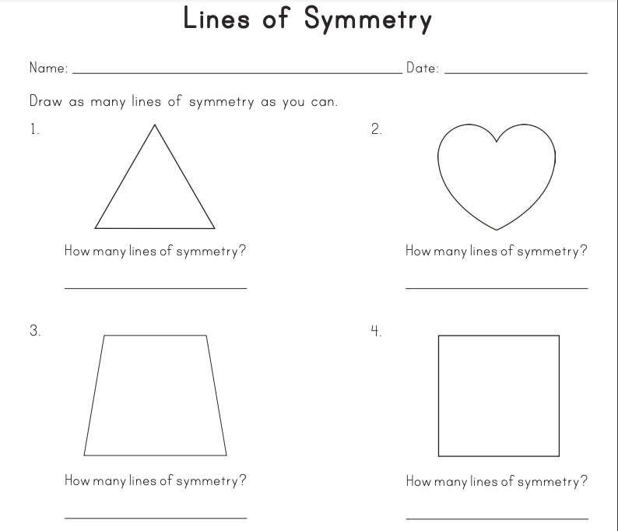

Draw these shapes into your book. How many lines of symmetry does each shape have?

Slide 25

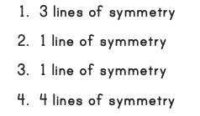
Check your answers...

Slide 26
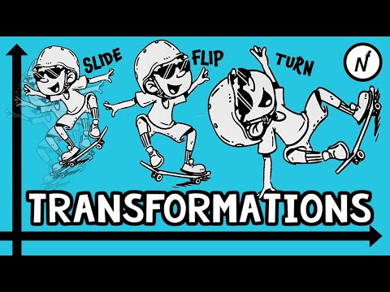

Do you remember the terms ‘slide, flip, turn’? Let’s recap...
Types of transformations:
Slide = a translation
Flip = a reflection
Turn = a rotation

Slide 27
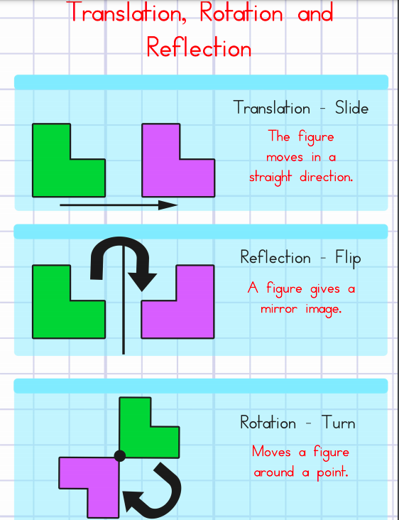



So to recap...

Slide 28
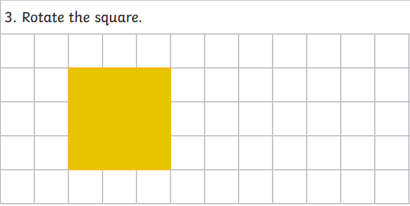
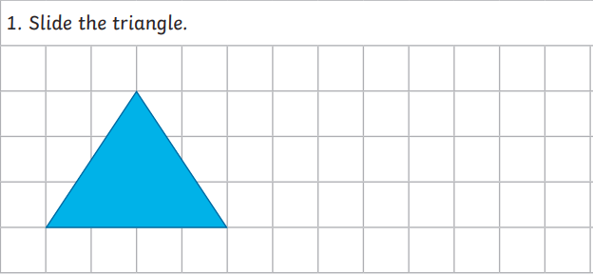
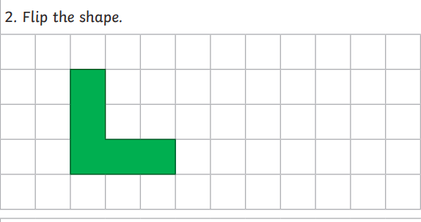
Your turn … draw these shapes in your book and complete the activity - be sure to label each transformation & send a photo to your teacher.

Slide 29
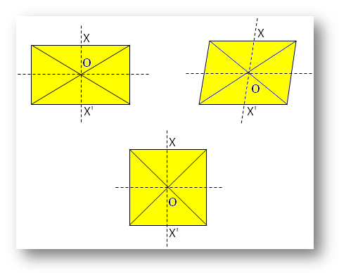
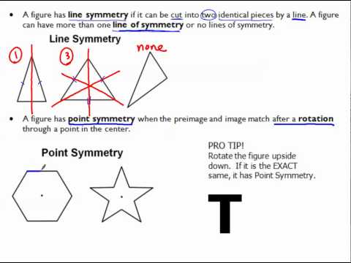

Now let’s look more closely at ‘point’ symmetry...

Slide 30
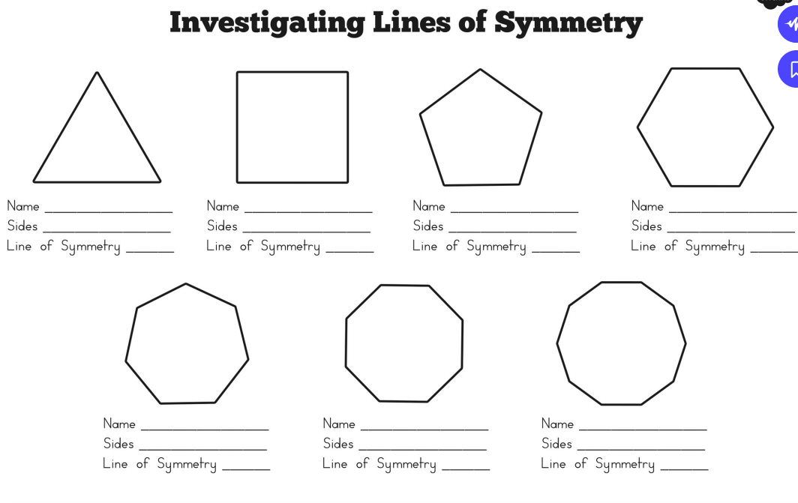
Use the toolbar above to draw the lines of symmetry in each shape.
Where would each point of symmetry be?
Insert a textbox over on the blank lines to write in your answers.

Slide 31
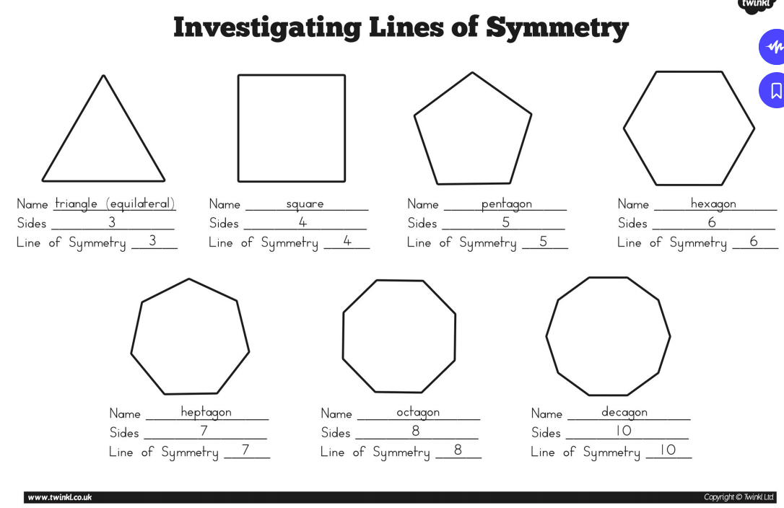
Check your answers

Slide 32

Let’s check your understanding of symmetry so far...
https://create.kahoot.it/share/duplicate-of-lines-of-symmetry/f2cae904-f6fc-4de1-9751-59864bac4b6e

Slide 33

Reflection...
How did you feel about today’s lesson?
Explain to a parent/carer or sibling what a transformation is.
Can you explain line symmetry and point symmetry?
What are some questions you have following today’s lesson?
On a scale of 1-5 (five being complete understanding), what would you score your understanding of line and point symmetry?

Slide 34
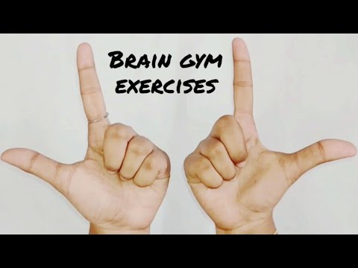
Brain Break:

Slide 35

Matific
Extension and Fast Finisher
Go to https://www.matific.com/au/en-au/login-page/
Complete tasks on matific

Slide 36
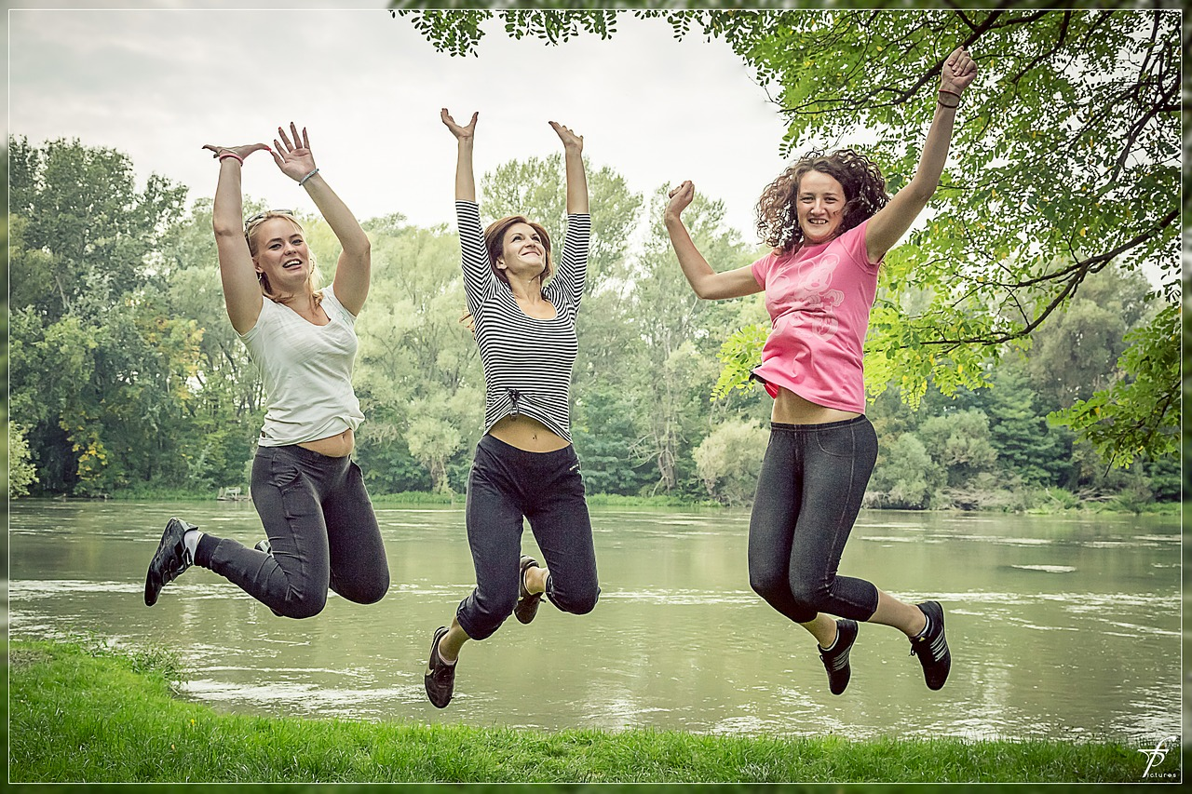
Break 2 - 30 minutes
Go outside.
Take this opportunity to run around outdoors.
Recharge and have a quick bite to eat so that you don’t become tired and irritable while you are sitting and working.
Drink plenty of water as well.

Slide 37



Slide 38


Slide 39
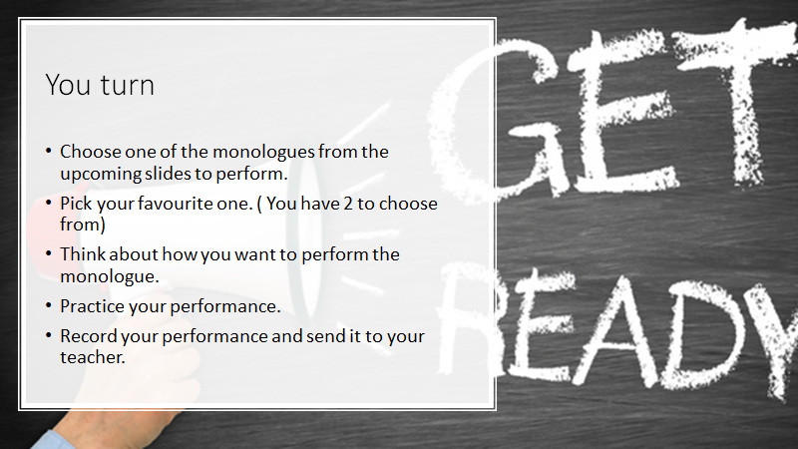

Slide 40
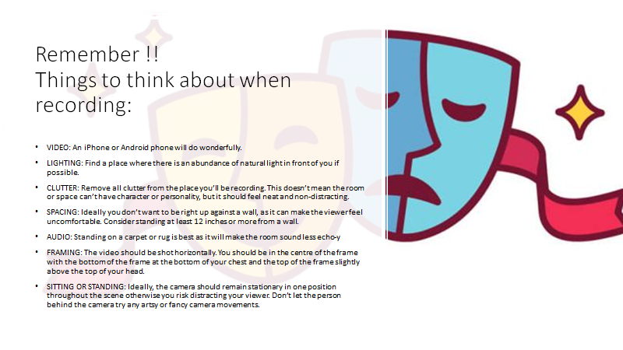

Slide 41
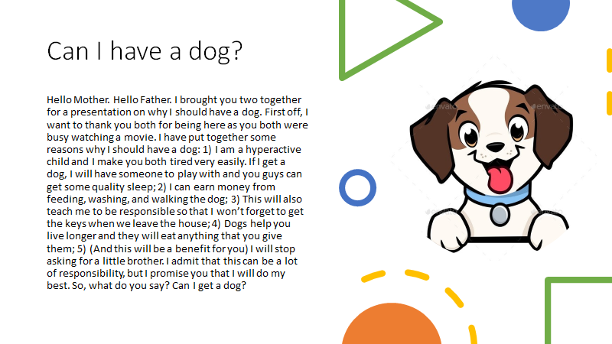

Slide 42
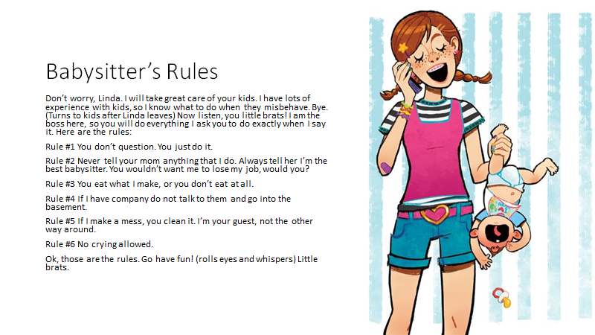

Slide 43
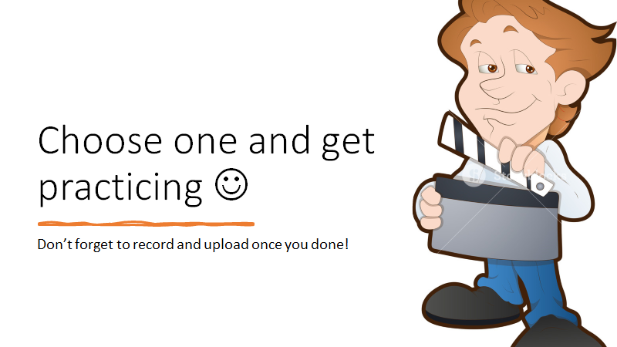

Slide 44



Slide 45


