Slide 1
Stage 3 Term 3-Week 6
Monday 16th of August 2021

Slide 2
Week 6 Spelling Lists
Look Cover Write check your spelling words in your book.
Record your list words using red for the consonants and blue for the vowels.
Then complete an activity from the spelling choice board.

Slide 3
Week 6 Words
 |  | Starfish | Seahorses | Turtles | Dolphins | Stingrays | Sharks
OLD words | 1 | afraid | few | pour | folk | youngling | supervise
 | 2 | waist | spew | court | yolk | weakling | television
 | 3 | wail | knew | your | folklore | seedling | evidence
 | 4 | raid | stew | four | folks | hatchling | advise
 | 5 | bail | brew | fourth | yolky | trifling | visible
 | 6 |  | pew | fourteen |  | earthling | revise
 | 7 |  |  | poured |  | inkling | vision
 | 8 |  |  |  |  | changeling | revision
New Sound |  | “all “as in ball | ue (as in glue) typically occurs at the end of words | wh as /h/ (as in whole) | st (as in castle) or silent t | -ery (meaning: relating to) Forms a noun | Phonic Concept: tactus, tangent (meaning: to touch)
New Words | 9 | stall | sue | whole | listen | archery | tactile
 | 10 | wall | glue | who | whistle | stationery | contact
 | 11 | football | true | whose | moisten | grocery | contagious
 | 12 | hall | blue | whom | glisten | pottery | tangent
 | 13 | call | flue | whosoever | listening | delivery | tangible
 | 14 |  | sued | wholemeal | thistle | mystery | tangentially
 | 15 |  |  | wholesale | wrestle | lottery | entanglement
 | 16 |  |  |  | unfasten | joinery | disentangle

Slide 4
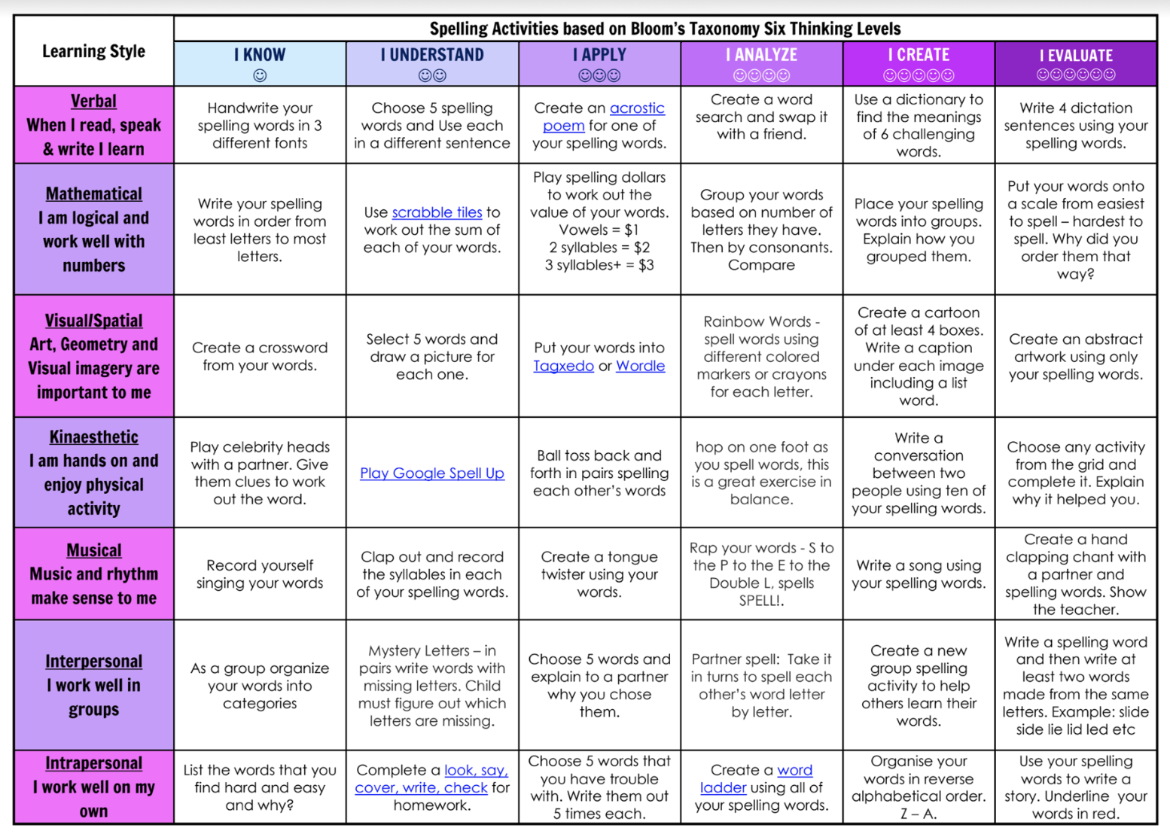
Spelling (20 minutes) - Look Cover Say Write Check your words. Complete an activity from the Spelling Choice Board.

Slide 5
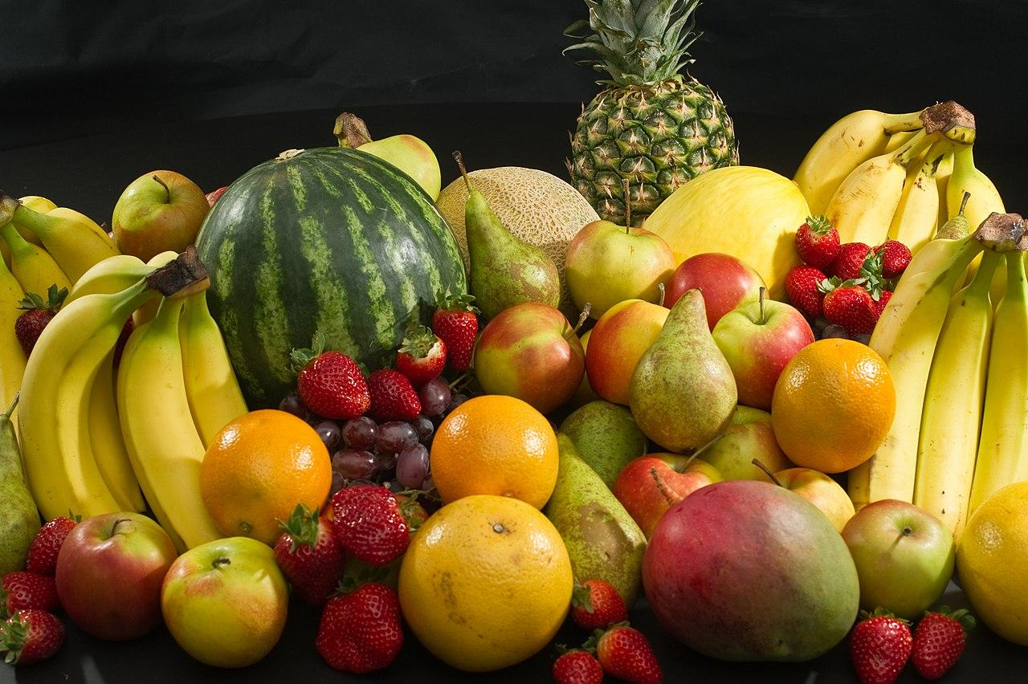
Fruit Break/ Brain Break:
Grab a piece of fruit or have a 10 minute break to go outside reset, refresh and restart.

Slide 6
Read works and Read Theory
Complete the reading passage and comprehension questions that have been provided by your class teacher in the google classroom.
This should take you 40-45 minutes to complete.

Slide 7
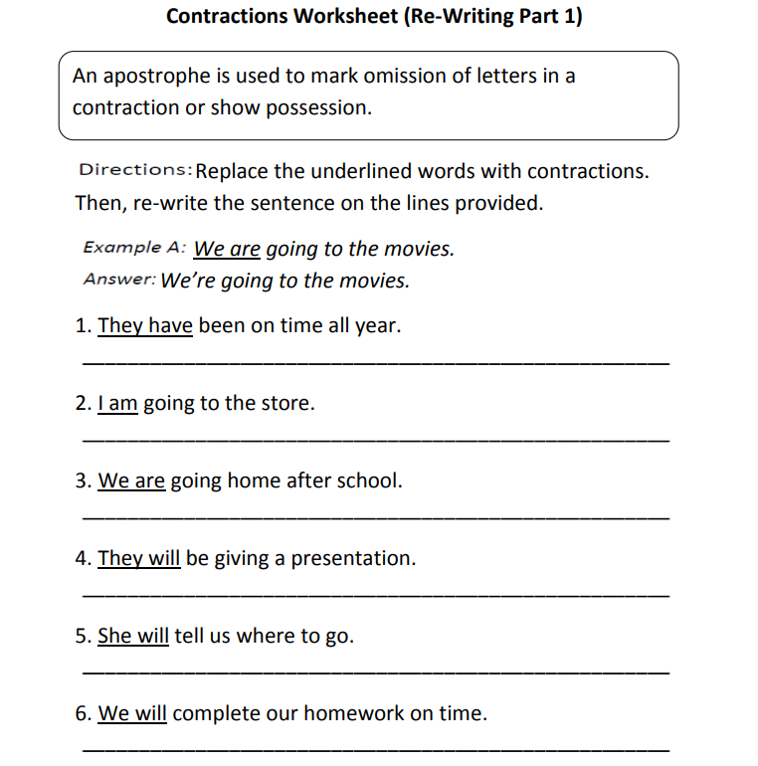
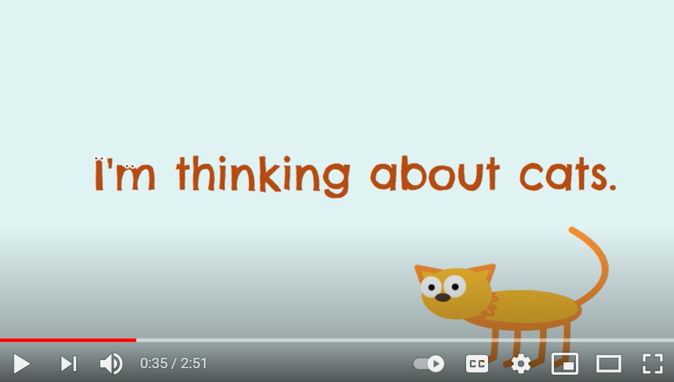

Slide 8
CHECK YOUR WORK
1. They’ve been on time all year.
2. I’m going to the store.
3. We’re going home after school.
4. They’ll be giving a presentation.
5. She’ll tell us where to go.
6. We’ll complete our homework on time.

Slide 9
Learning Support
If you are working with Ms Carrington, Mrs Waggie or Mrs McCormick in Term 3, you will find your work in the Learning Support Google Classroom.
Everyone else, please go to the next slide.

Slide 10
EDITING
Rewrite the passage making the corrections listed at the bottom of the slide.

Slide 12
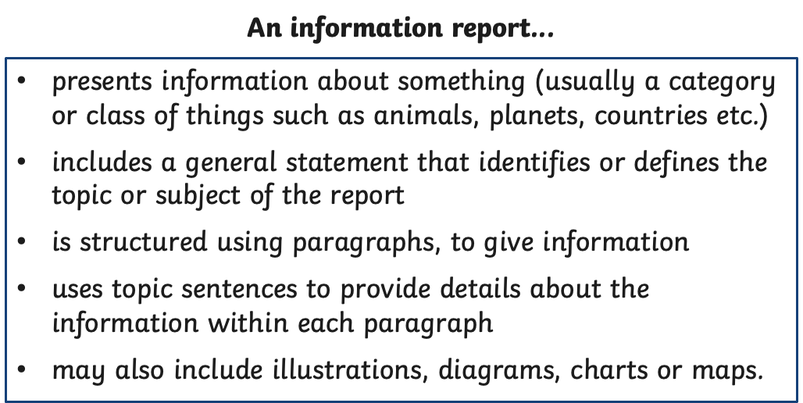
For the next few weeks, we will be looking at informative writing. Have a read of the information in the next few slides.

Slide 13
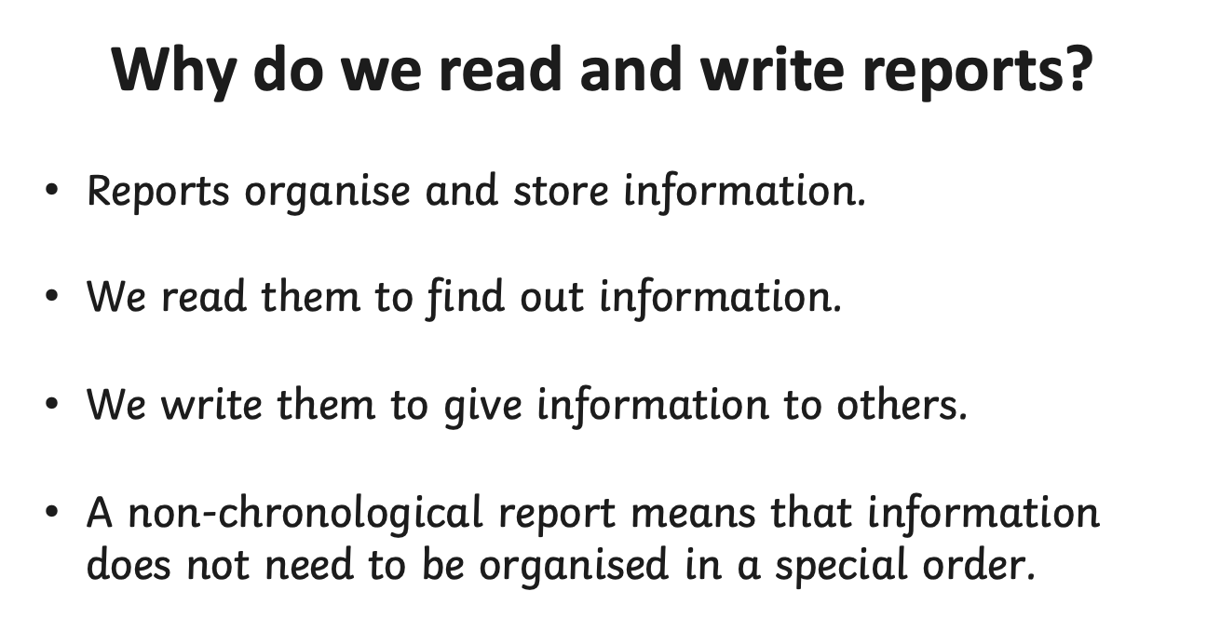

Slide 15
Here is some general information about Orcas.
Where might this information go in a report?
How does general information help us understand the topic better?
Is this sufficient information to start our report?
Where else can you find information about Orcas?
Circle the vocabulary specific to informative writing

Slide 16
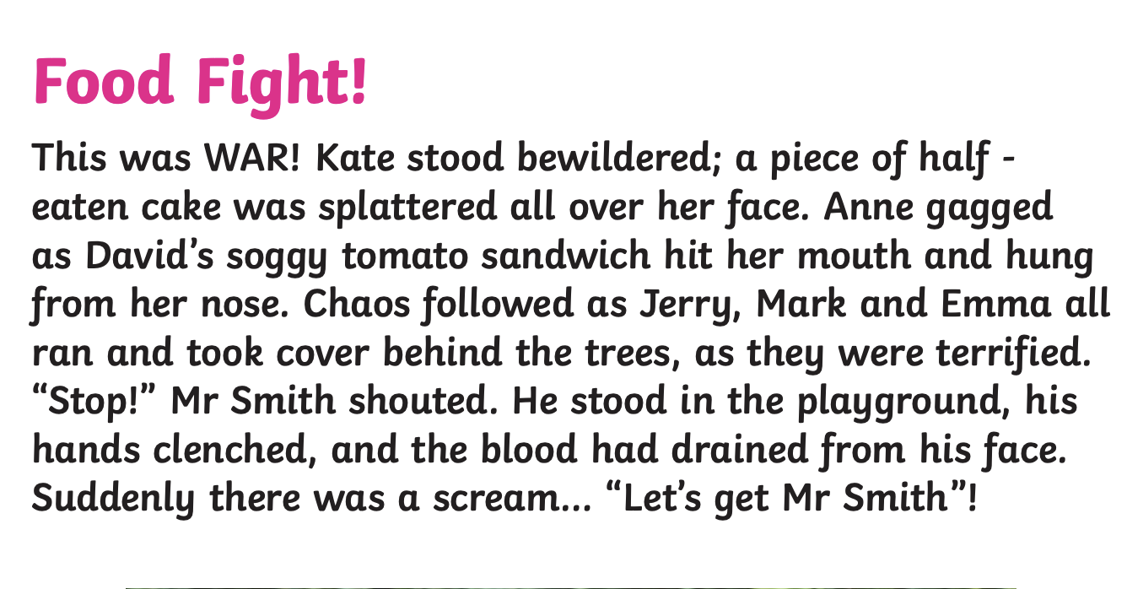
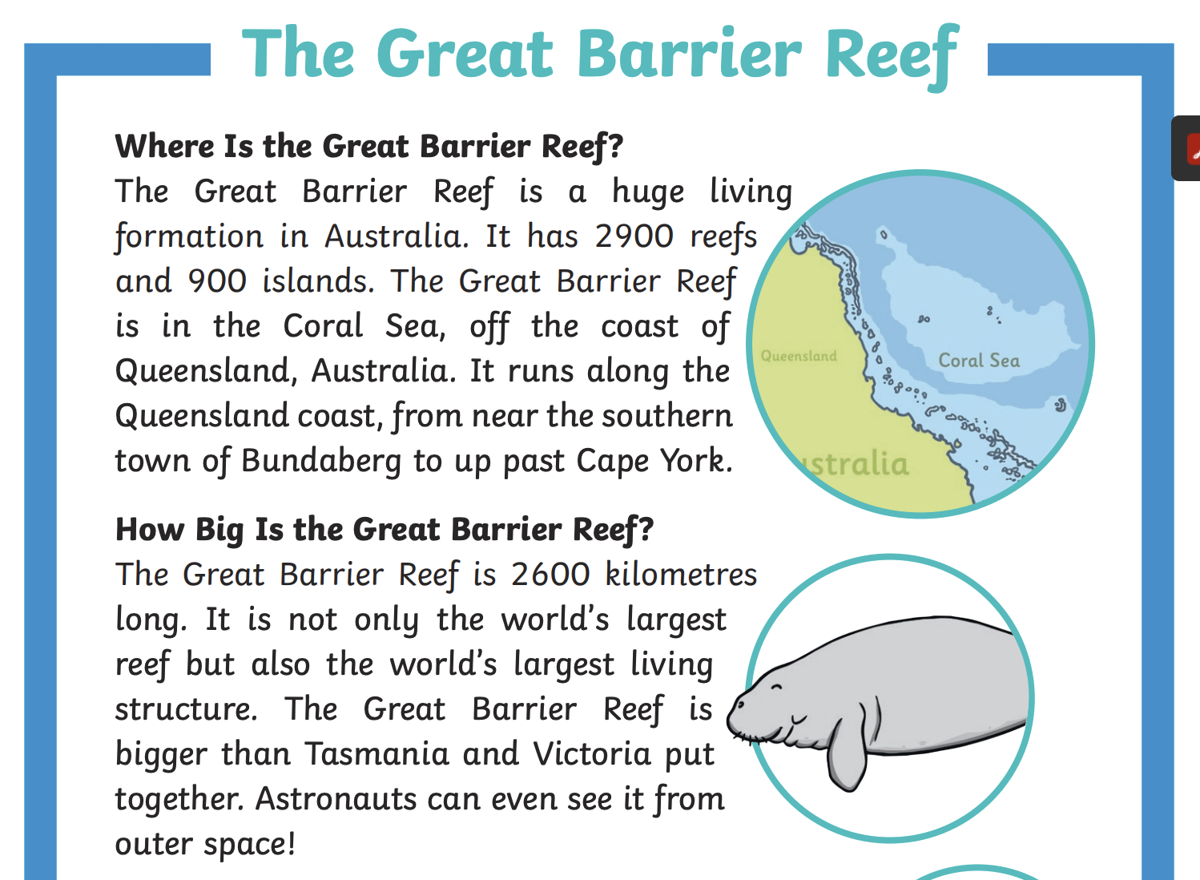
Can you identify the text type of these excerpts?

Slide 17
PUBLIC SPEAKING NEWS
Notes were handed out at the end of TERM 2. THE MAIN POINTS WERE
In STAGE 3
Prepared speeches should go for 4 mins
Stage Three students should state their point of view and then be encouraged to link their ideas to an issue or problem in society.
They should be linking ideas to other people and the world in general for their entire speech.
Give the audience a reason to care
Practice good eye contact and voice projection
Make sure your speech has a clear beginning, middle and end.
You can choose on of the topics below or YOUR OWN FREE CHOICE
THE TOPICS ARE
* My future career
*I’m inspired by ....... because
*If I could have a superpower, it would be….
`
Keep working on your speech for the Public Speaking Competition. When we do return to school we plan to go ahead with the speeches.
The finals may happen in the live stream format just like last year.
So keep working on your speech as it is part of your speaking and listening program for Term 3 and it will be assessed when we go back to school.

Slide 18
Handwriting/ Typing :
As part of the curriculum we need to learn how to effectively type and use digital technologies. Google Typing Club and take their placement test then complete one or more of the lessons. This should take 20 -30 minutes.

Slide 19
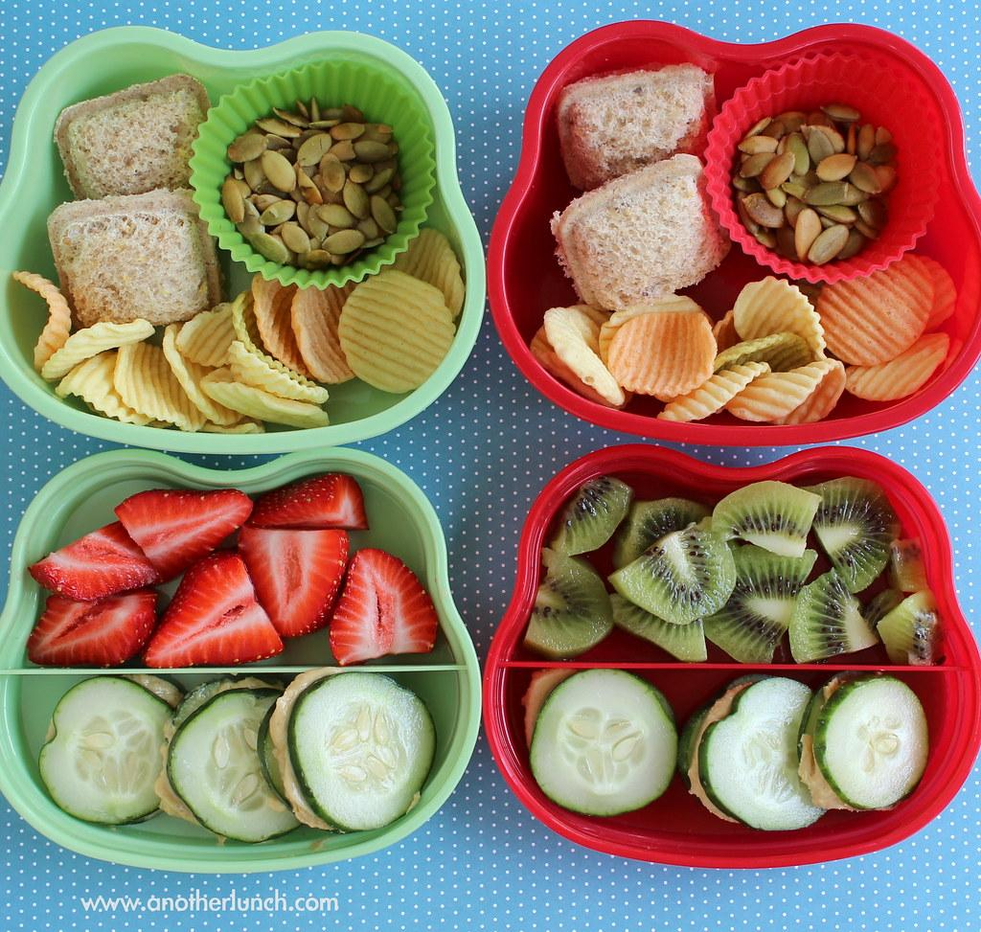
Lunch break-Break 1
Enjoy the 30 minute lunch break with your family.
Try to eat something healthy and drink some water.

Slide 20
Middle Session
Numeracy: Numeracy Ninjas
Week 6 Session 1

Slide 21
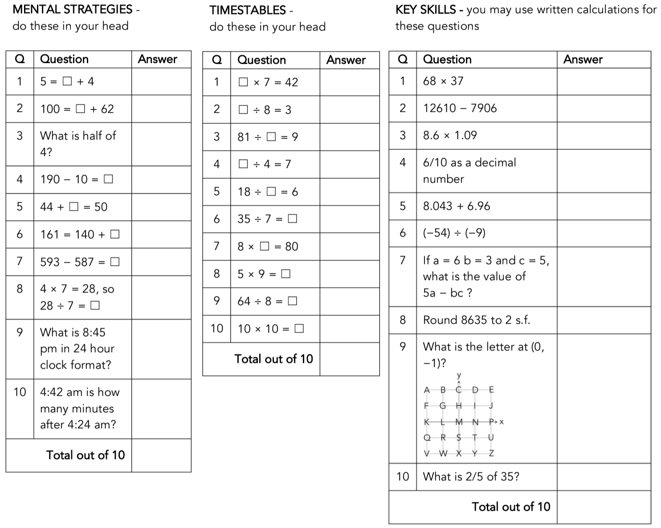
Numeracy Ninjas:
Complete the questions. You have 5 -10 minutes.
Numeracy Ninjas Week 16 Session 1

Slide 22
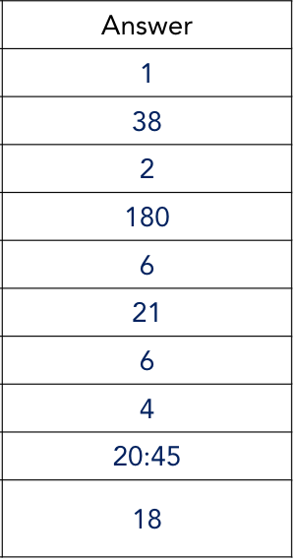
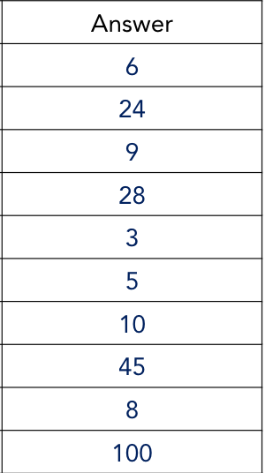
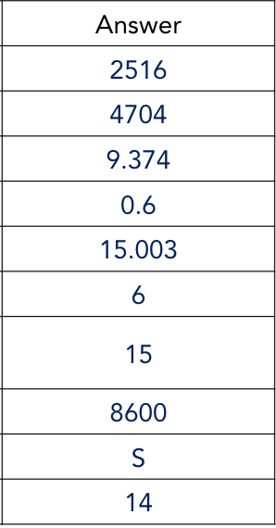
Numeracy Ninjas: ANSWERS
Mental Strategies Times Tables Key Skills
Numeracy Ninjas Week 16 Session 1

Slide 23
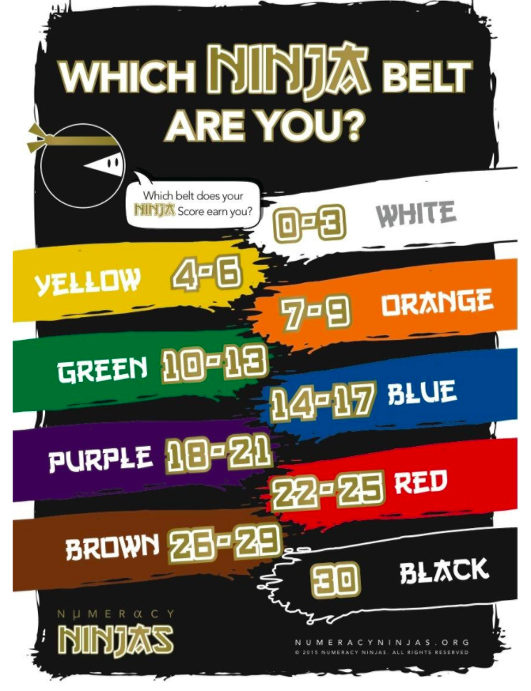
Numeracy Ninjas; Which Belt Are You?

Slide 24
Maths - Decimals
I am learning to:
Recognise that the place value system can be extended beyond hundredths
Interpret decimal notation for thousandths
State the place value of digits in decimal numbers of up to three decimal places

Slide 25
What do we already know about decimals?
→ let’s brainstorm our prior knowledge on decimals
Think about....
Why do we use decimals?
Where do you find decimals?
The correct way to use decimals.
Create a mindmap or begin a KWL chart to record your answers!

Slide 26
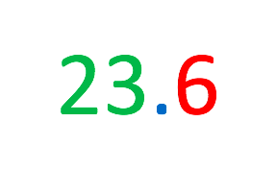
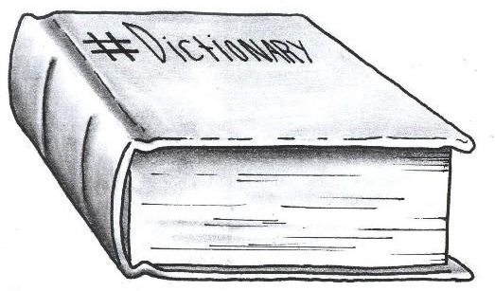
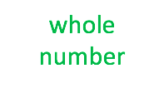
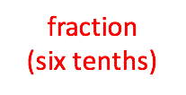
What is a decimal:
A decimal is a number which contains a decimal point.
Decimal numbers may be less than or greater than 0.
The decimal point is used to separate the whole numbers (the units, tens and hundreds) from the fractions (the tenths, hundredths and thousandths). For this reason, it is always placed between the units column and the tenths column.

Slide 27
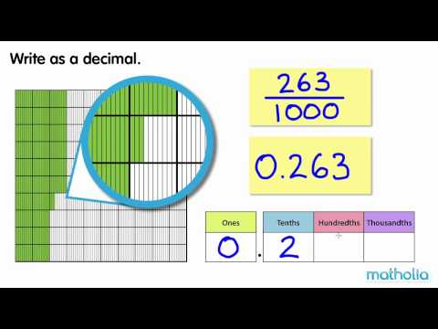
Decimals
Remember ...
•When writing whole numbers, each digit holds a place. This place represents the value of that digit within the number.
•When writing decimal fractions, place value is equally important. The place represents the value of the fraction within the decimal.
2 8 3 0 . 2 8 3
Watch the video:
https://www.youtube.com/watch?v=mbZHJdpX1S0
Hundreds Tens Units
Tenths
Hundredths
Thousandths

Slide 28
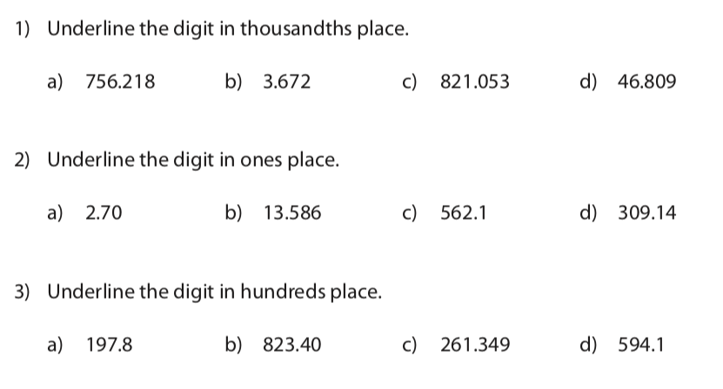
Decimals: Underline the Digit
Have a go!
In your book.

Slide 29
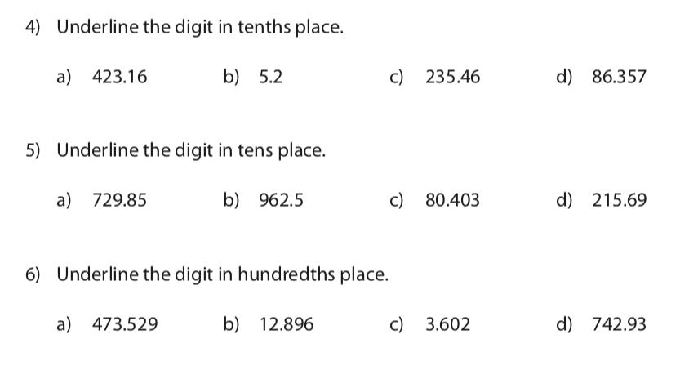
Decimals: Underline the Digit
Have a go!
In your book.

Slide 30
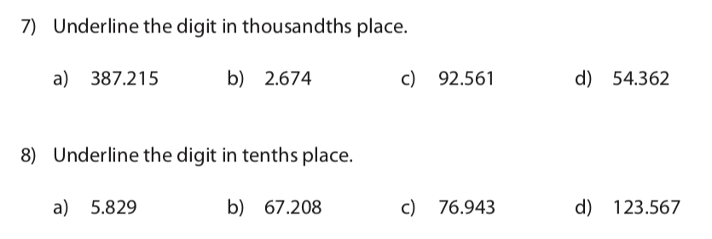
Decimals: Underline the Digit
Have a go!
In your book.

Slide 31
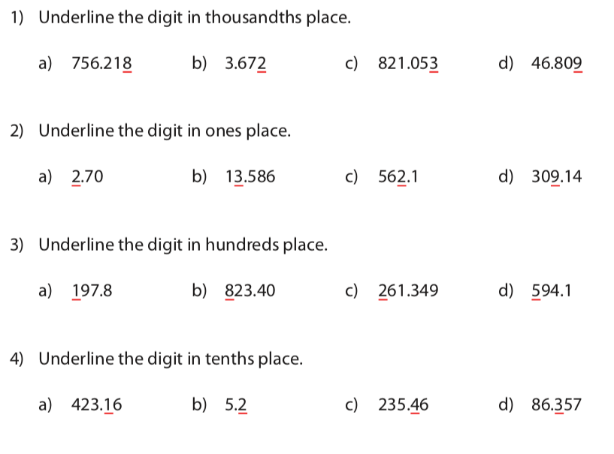
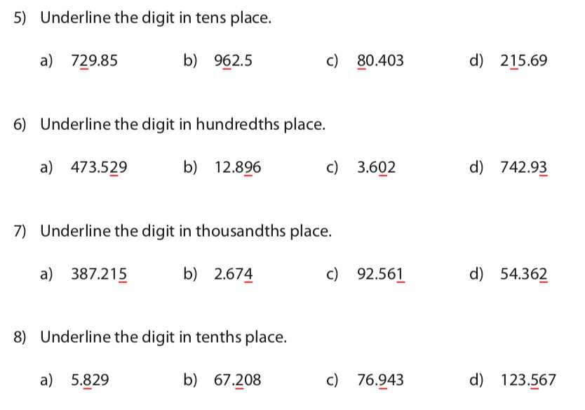
Decimals: Underline the Digit

Slide 32
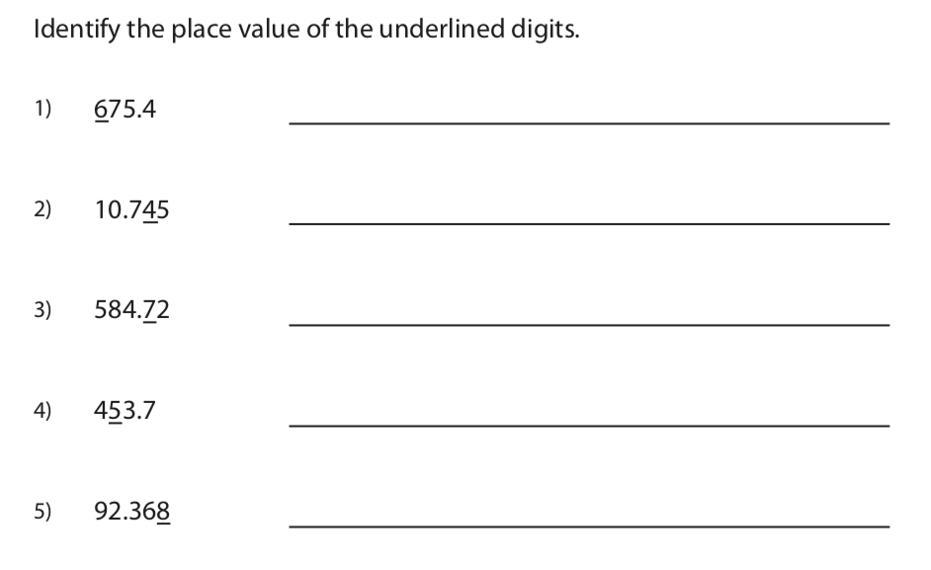
Decimals: Place Value of Underlined Digits
Have a go!
In your book.

Slide 33
Decimals: Place Value of Underlined Digits
Have a go!
In your book.

Slide 34
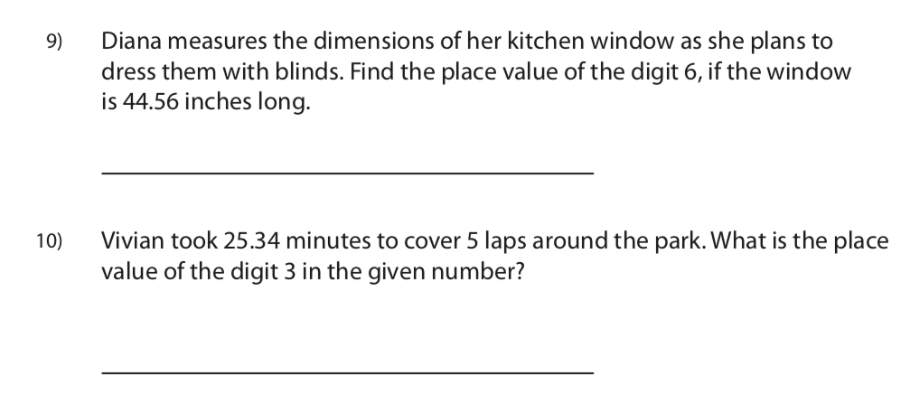
Decimals: Place Value of Underlined Digits
Have a go!
In your book.

Slide 35
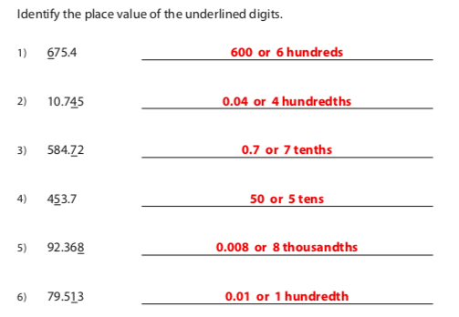
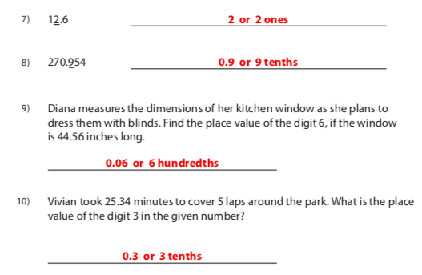
Decimals: Place Value of Underlined Digits

Slide 36
Brain Break:
Go outside and lie on the ground look up at the clouds.
See if you can make some pictures with the clouds as they are moving.
Give yourself 5 minutes to do this task.

Slide 37
Matific
Extension and Fast Finisher
Go to https://www.matific.com/au/en-au/login-page/
Complete tasks on matific

Slide 38
Break 2: 30 minutes
Go outside.
Take this opportunity to run around outdoors.
Recharge and have a quick bite to eat so that you don’t become tired and irritable while you are sitting and working.
Drink plenty of water as well.

Slide 39
LEARNING EXPERIENCE 4 -
WHY AND HOW DID THE AUSTRALIAN COLONY DEVELOP IN THE 1800’S?
Inquisitive - Enjoy teaching Science, History and Geography (click this link)
Why were the colonies founded > Lesson 3 A Colonial Settlement Investigation
Watch the video on primary and secondary sources
https://www.youtube.com/watch?v=pup5eVSbGkE
Your turn to decide what kind of sources the following are:

Slide 40
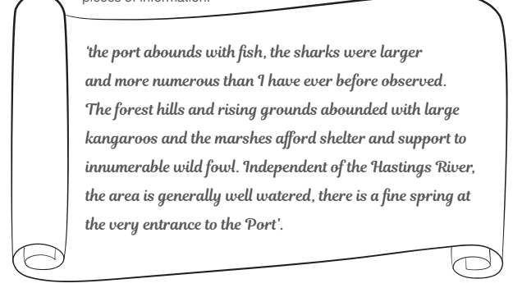
A colonial case study
An extract from John Oxley’s notebook

Slide 41
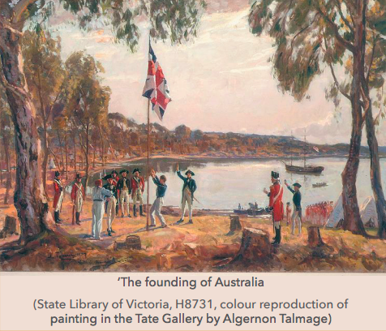
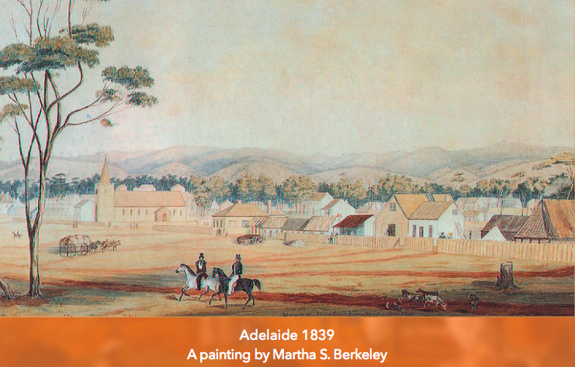
What about these two images? Primary or secondary

Slide 42
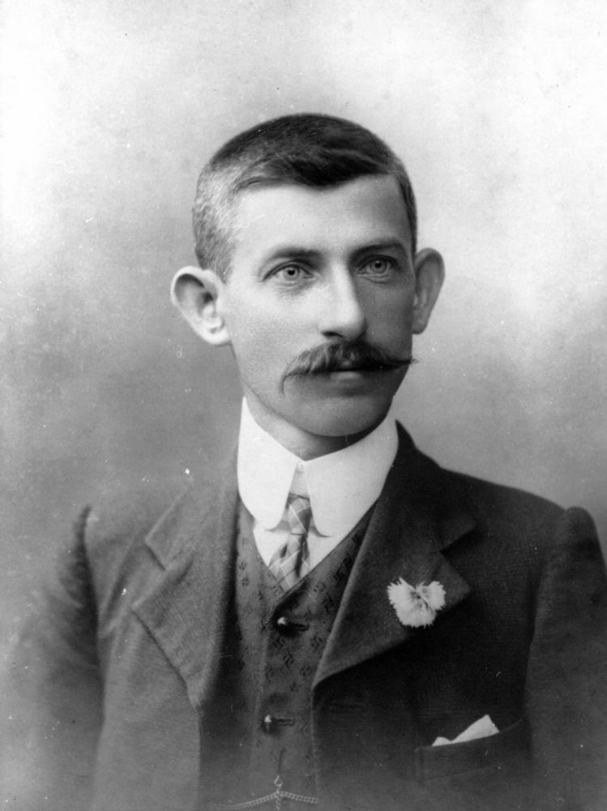
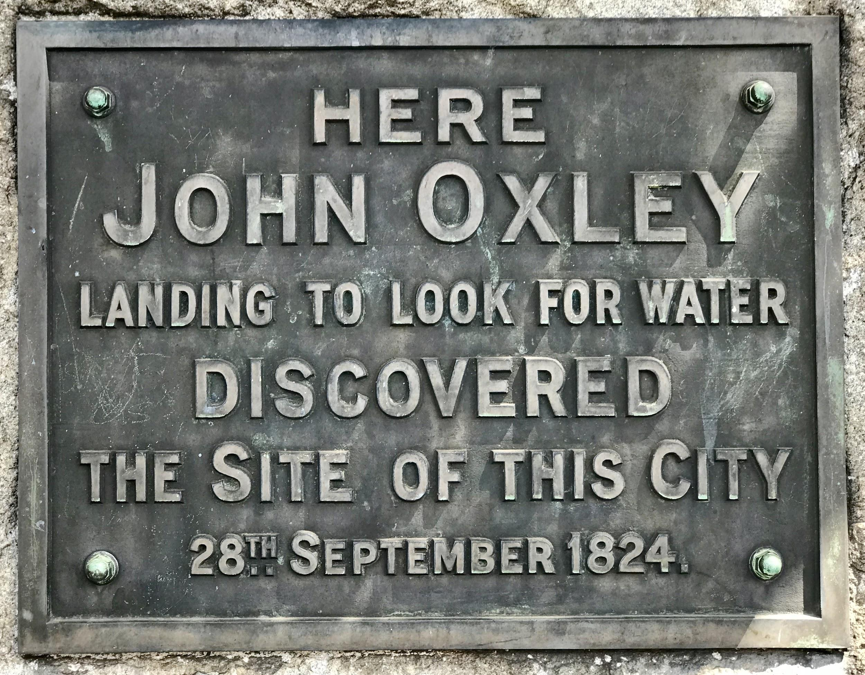
Let’s look at Port Macquarie on the map
https://www.google.com.au/maps/place/Port+Macquarie+NSW+2444/@-31.4611373,152.8586813,13z/data=!3m1!4b1!4m5!3m4!1s0x6b9dff5c34ecc9c1:0x50609b490442e40!8m2!3d-31.433333!4d152.9
Why did John Oxley recommend this area as an appropriate site for settlement?

Slide 43
Try this Kahoot quiz on John Oxley:
https://create.kahoot.it/share/do-you-know-john-oxley/b475b686-6de7-4459-b81f-5b92ee9c1a71

