Slide 1
Stage 3 Term 3-Week 5
Tuesday 10th of August 2021

Slide 2
Week 5 Spelling Lists
Look Cover Write check your spelling words in your book.
Record your list words using red for the consonants and blue for the vowels.
Then complete an activity from the spelling choice board.

Slide 3
Week 5 Words
 |  | Starfish | Seahorses | Turtles | Dolphins | Stingrays | Sharks
OLD words | 1 | stay | due | restore | halftime | linear | circumstantiate
 | 2 | delay | hue | score | half | muscular | circuit
 | 3 | decay | cue | before | half hearted | seminar | circumference
 | 4 | slay | duel | adore | balm | perpendicular | circumscribe
 | 5 | holiday | rescue | wore | calm | calendar | circumstance
 | 6 |  | residue | tore | embalm | spectacular | circumspect
 | 7 |  |  | shore | calves | molecular | circumvent
 | 8 |  |  |  | qualm | caterpillar | circumflex
New Sound |  | “ai” as in rain | ew (as in new) typically occurs at end of words | our (as in pour) [our=/or/] | ol as /oa/ (as in yolk) or silent l | -ling (meaning: little, younger or inferior) | Concept: visum, video (meaning: see)
New Words | 9 | afraid | few | pour | folk | gosling | visible
 | 10 | waist | spew | court | yolk | sibling | revise
 | 11 | wail | knew | your | folklore | earthling | vision
 | 12 | raid | stew | four | folks | fledgling | revision
 | 13 | bail | brew | fourth | yolky | inkling | visionary
 | 14 |  | pew | fourteen |  | darkling | visualise
 | 15 |  |  | poured |  | underling | invisible
 | 16 |  |  |  |  | lordling | improvise

Slide 4
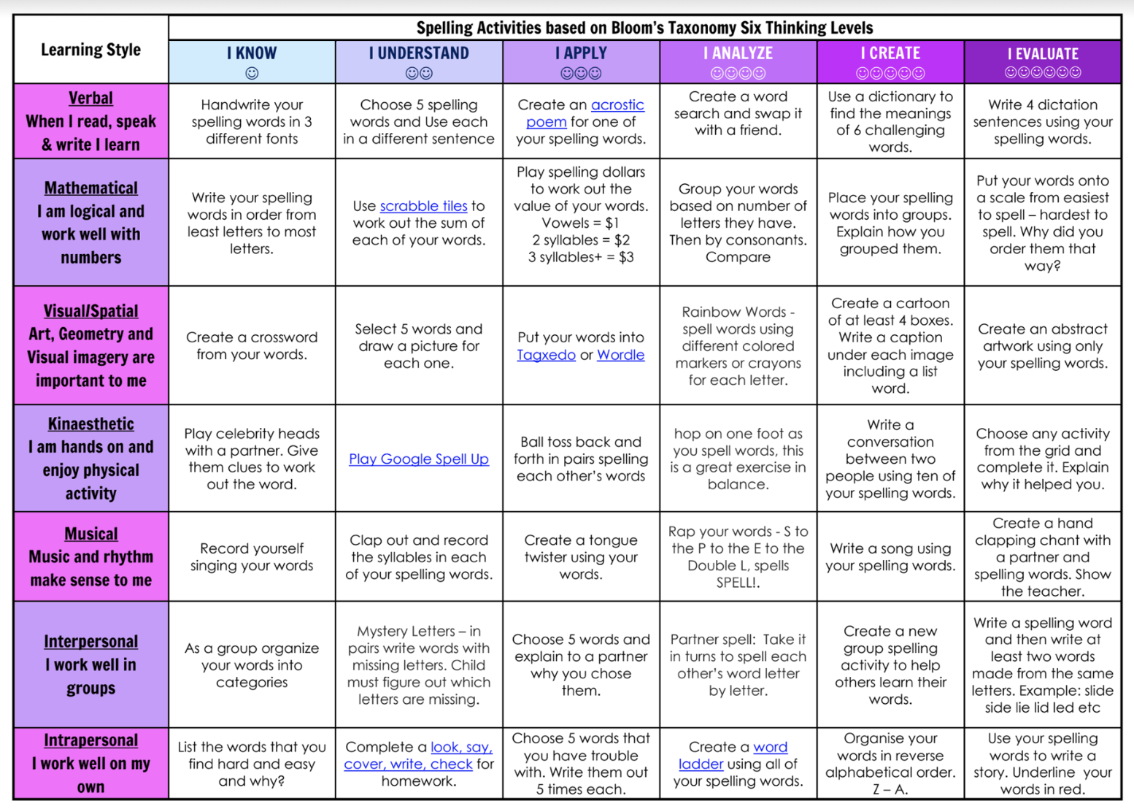
Spelling (20 minutes) - Look Cover Say Write Check your words. Complete an activity from the Spelling Choice Board.

Slide 5
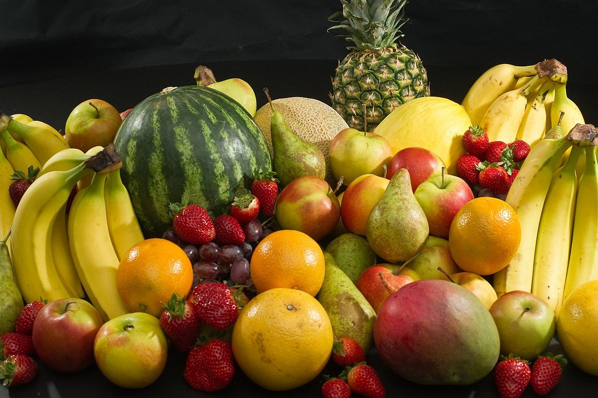
Fruit Break/ Brain Break:
Grab a piece of fruit or have a 10 minute break to go outside reset, refresh and restart.

Slide 6
Read works and Read Theory
Complete the reading passage and comprehension questions that have been provided by your class teacher in the google classroom.
This should take you 40-45 minutes to complete.

Slide 7
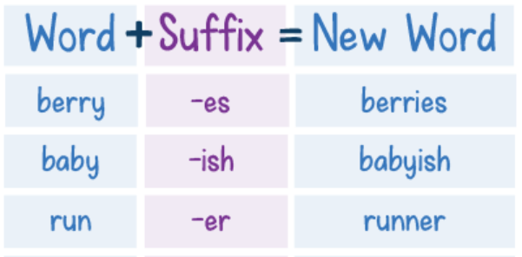
Grammar and Punctuation
Today, we’ll be looking at using suffixes.
Suffixes are added to the end of a word to make a new word. It usually changes the meaning of the base word.
https://www.youtube.com/watch?v=635oQTY61J8

Slide 8
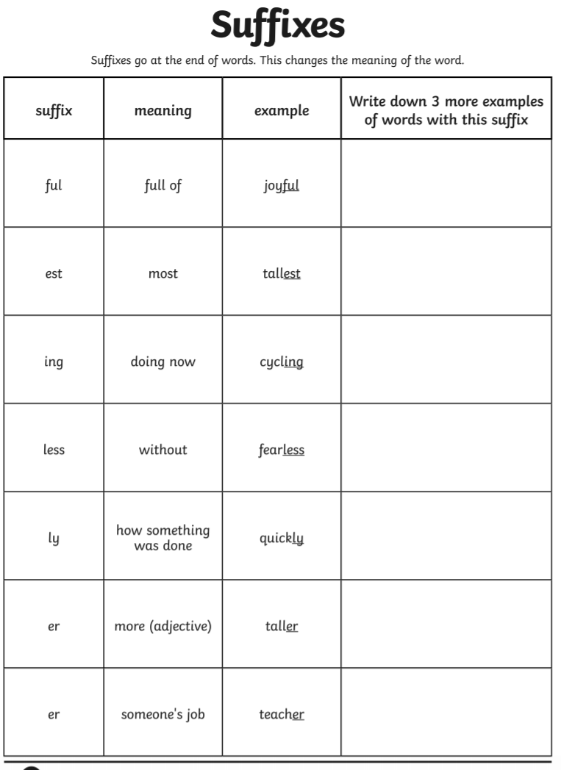
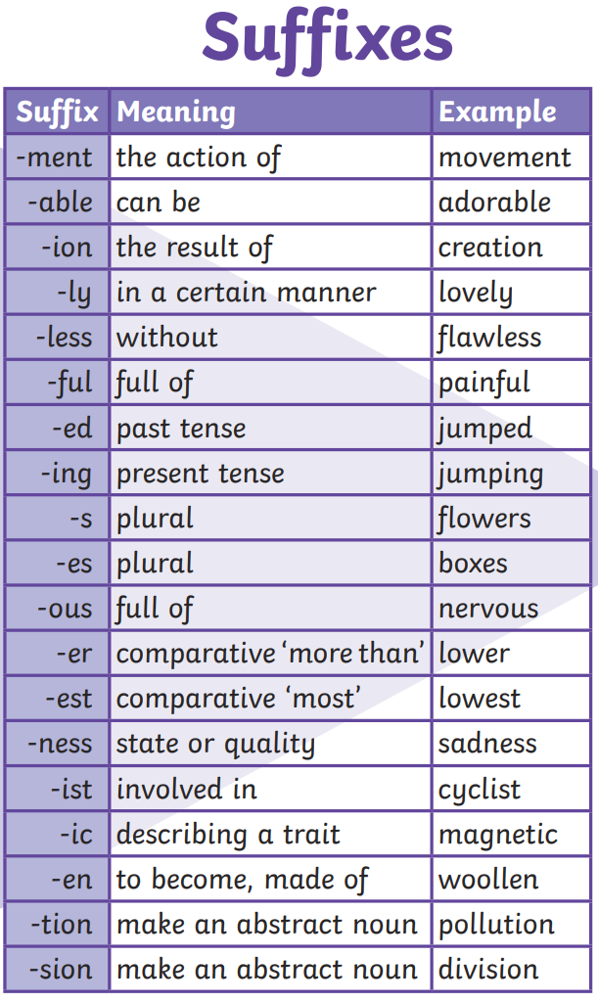

Slide 9
Learning Support
If you are working with Ms Carrington, Mrs Waggie or Mrs McCormick in Term 3, you will find your work in the Learning Support Google Classroom.
Everyone else, please go to the next slide.

Slide 10
EDITING
Rewrite the passage making the corrections listed at the bottom of the slide.

Slide 12
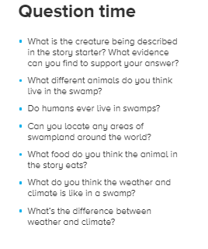
Continue the story using the prompt and picture.
You can use the questions on the slide to help you get started.

Slide 13
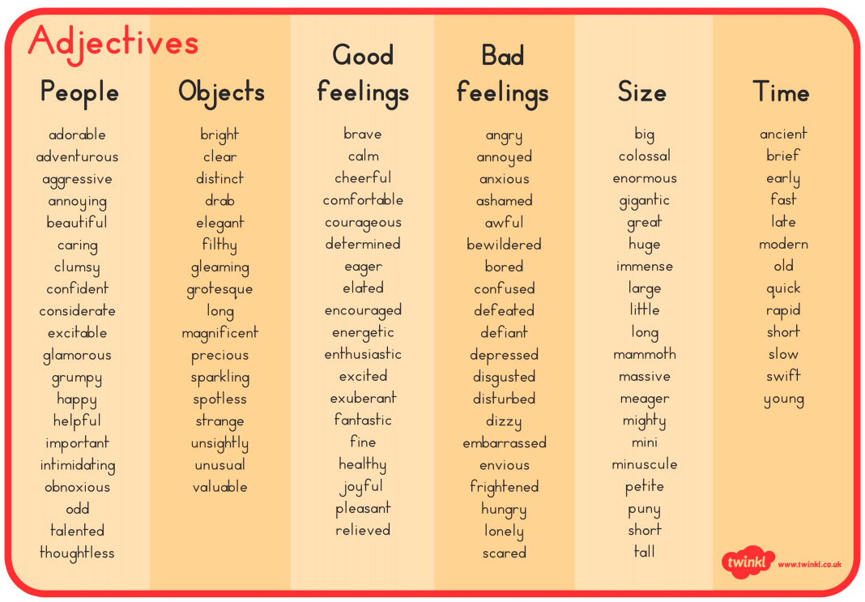

Slide 14
PUBLIC SPEAKING NEWS
Notes were handed out at the end of TERM 2. THE MAIN POINTS WERE
In STAGE 3
Prepared speeches should go for 4 mins
Stage Three students should state their point of view and then be encouraged to link their ideas to an issue or problem in society.
They should be linking ideas to other people and the world in general for their entire speech.
Give the audience a reason to care
Practice good eye contact and voice projection
Make sure your speech has a clear beginning, middle and end.
You can choose on of the topics below or YOUR OWN FREE CHOICE
THE TOPICS ARE
* My future career
*I’m inspired by ....... because
*If I could have a superpower, it would be….
Keep working on your speech for the Public Speaking Competition. When we do return to school we plan to go ahead with the speeches.
The finals may happen in the live stream format just like last year.
So keep working on your speech as it is part of your speaking and listening program for Term 3 and it will be assessed when we go back to school.

Slide 15
Handwriting/ Typing :
As part of the curriculum we need to learn how to effectively type and use digital technologies. Google Typing Club and take their placement test then complete one or more of the lessons. This should take 20 -30 minutes.

Slide 16
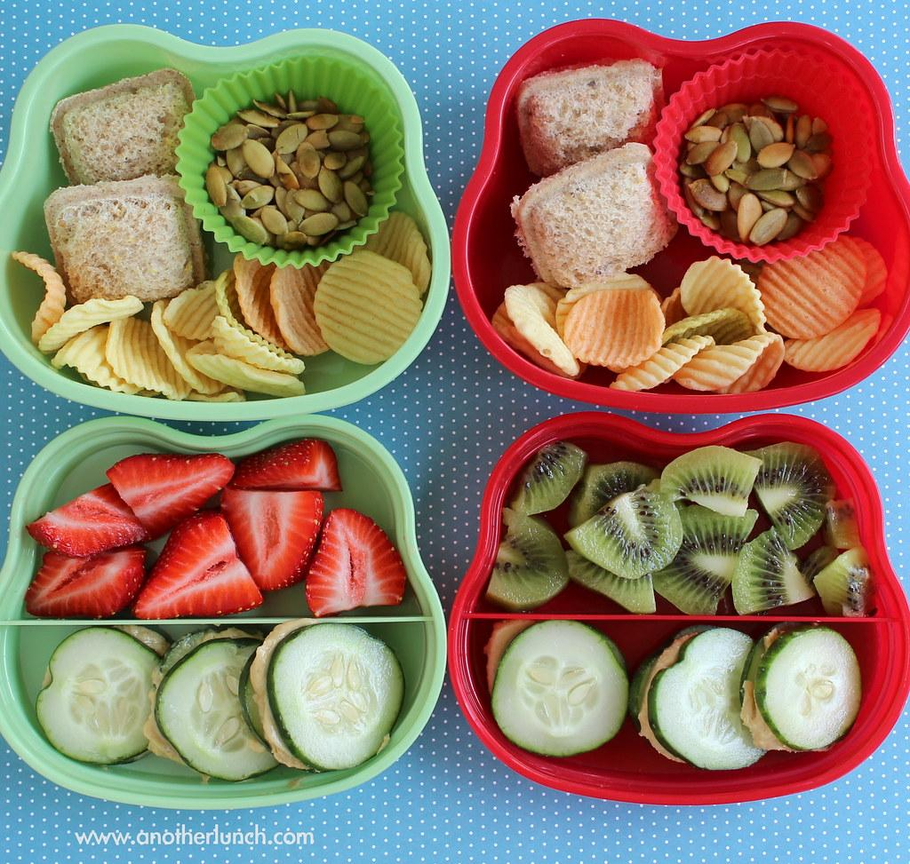
Lunch break-Break 1
Enjoy the 30 minute lunch break with your family.
Try to eat something healthy and drink some water.

Slide 17
Middle Session
Numeracy: Numeracy Ninjas
Week 5 : Session 2

Slide 18
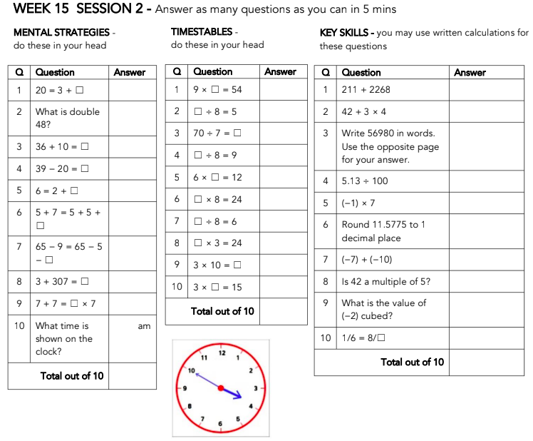
Numeracy Ninjas:
Complete the questions you have 5 -10 minutes
Numeracy Ninjas Week 15 Session 2

Slide 19
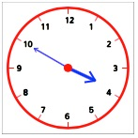
Numeracy Ninjas: ANSWERS
Q | Question | Answer
1 | 20 = 3 + ☐ | 17
2 | What is double 48? | 96
3 | 36 + 10 = ☐ | 46
4 | 39 − 20 = ☐ | 19
5 | 6 = 2 + ☐ | 4
6 | 5 + 7 = 5 + 5 + ☐ | 2
7 | 65 − 9 = 65 − 5 − ☐ | 4
8 | 3 + 307 = ☐ | 310
9 | 7 + 7 = ☐ × 7 | 2
10 | What time is shown on the clock? | 3:50 am
Numeracy Ninjas Week 15 Session 2

Slide 20
Numeracy Ninjas...Check your answers...
Q | Question | Answer
1 | 9 × ☐ = 54 | 6
2 | ☐ ÷ 8 = 5 | 40
3 | 70 ÷ 7 = ☐ | 10
4 | ☐ ÷ 8 = 9 | 72
5 | 6 × ☐ = 12 | 2
6 | ☐ × 8 = 24 | 3
7 | ☐ ÷ 8 = 6 | 48
8 | ☐ × 3 = 24 | 8
9 | 3 × 10 = ☐ | 30
10 | 3 × ☐ = 15 | 5
Q | Question | Answer
1 | 211 + 2268 | 2479
2 | 42 + 3 × 4 | 54
3 | Write 56980 in words. Use the opposite page for your answer. | Fifty six thousand, nine hundred and eighty
4 | 5.13 ÷ 100 | 0.0513
5 | (−1) × 7 | −7
6 | Round 11.5775 to 1 decimal place | 11.6
7 | (−7) + (−10) | −17
8 | Is 42 a multiple of 5? | No
9 | What is the value of (−2) cubed? | −8
10 | 1/6 = 8/☐ | 48

Slide 21
How’d you go?

Slide 22
Maths - Mental and Written Multiplication Strategies
I am learning to:
Use efficient mental and written strategies to multiply whole numbers of up to four digits by one- and two-digit numbers
Solve word problems involving multiplication

Slide 23
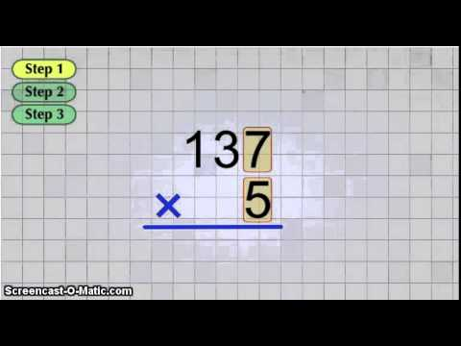
Multiplication Algorithms...

Slide 24
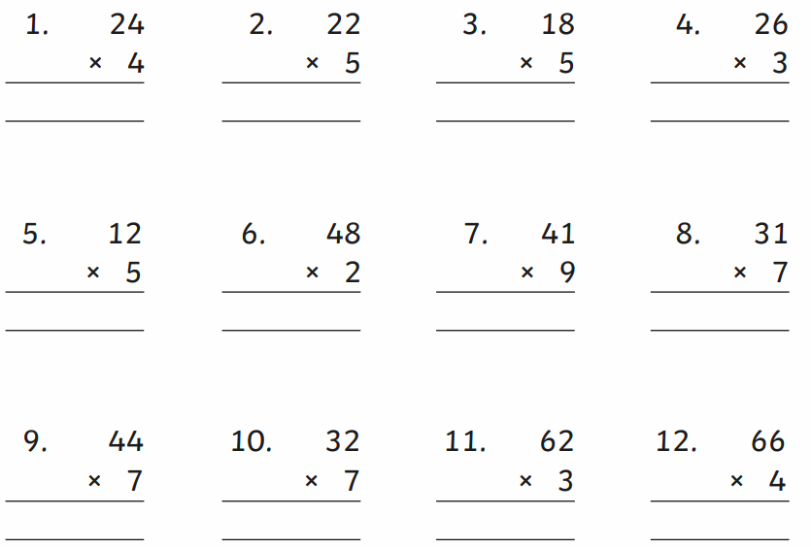
Your turn… complete these in your book

Slide 25
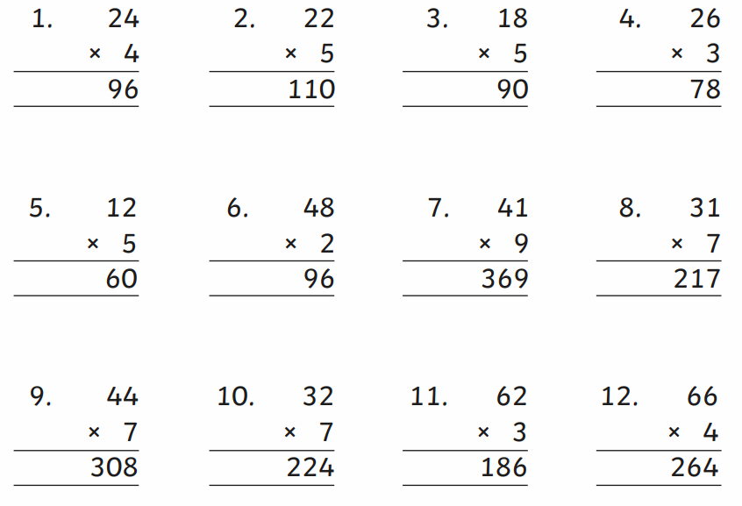
Check your answers and be sure to send a photo to your teacher to show your working out...

Slide 26
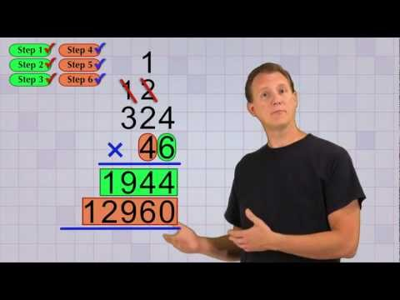
Multiplying Multi Digit Numbers...
Watch carefully before having a go.

Slide 27
Your turn...copy these algorithms into your book and show your working out.

Slide 28
Check you answers & don’t forget to send your work to your teacher...

Slide 29
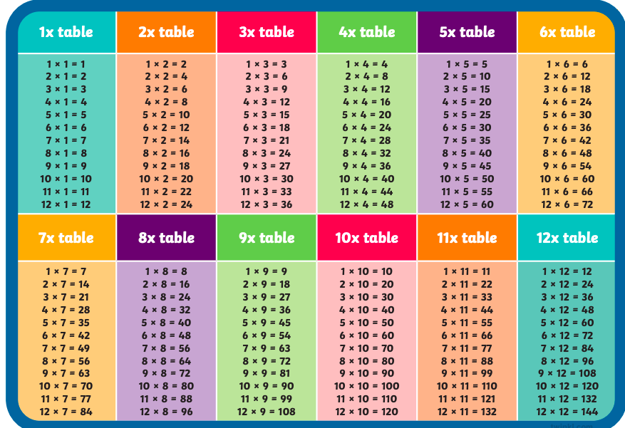
Let’s step it up ...if you’re not confident with your times tables, use the cheat sheet below to help you...

Slide 30
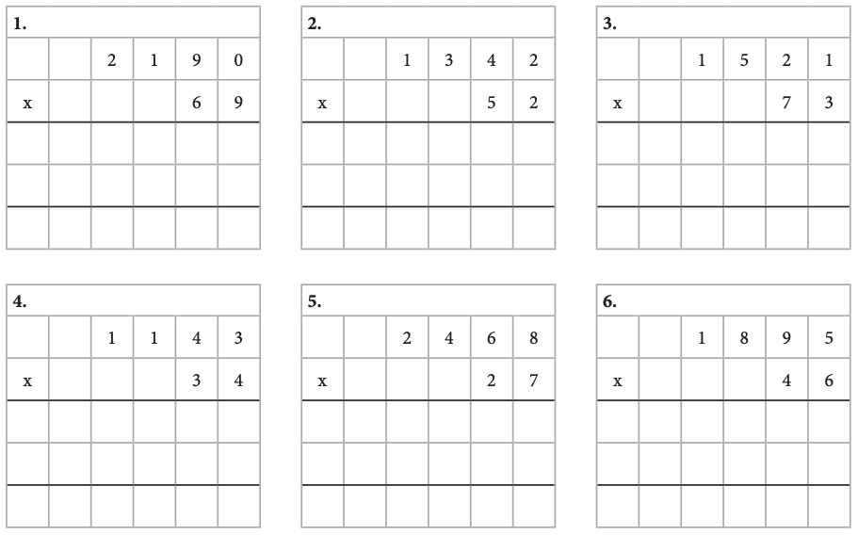
Copy these algorithms into your book and show your working out… don’t forget ‘magic zero’

Slide 31
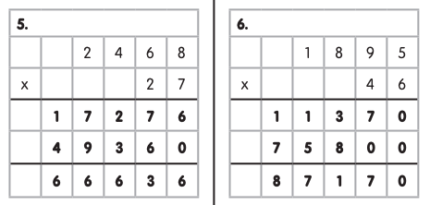
Check your answers...

Slide 32
Reflection...
How did you feel about today’s lesson?
Did your accuracy improve in calculating algorithms?
Ask a family member to create an algorithm for you to solve

Slide 33
Brain Break:

Slide 34
Matific
Extension and Fast Finisher
Go to https://www.matific.com/au/en-au/login-page/
Complete tasks on matific

Slide 35
Break 2: 30 minutes
Go outside.
Take this opportunity to run around outdoors.
Recharge and have a quick bite to eat so that you don’t become tired and irritable while you are sitting and working.
Drink plenty of water as well.

Slide 36
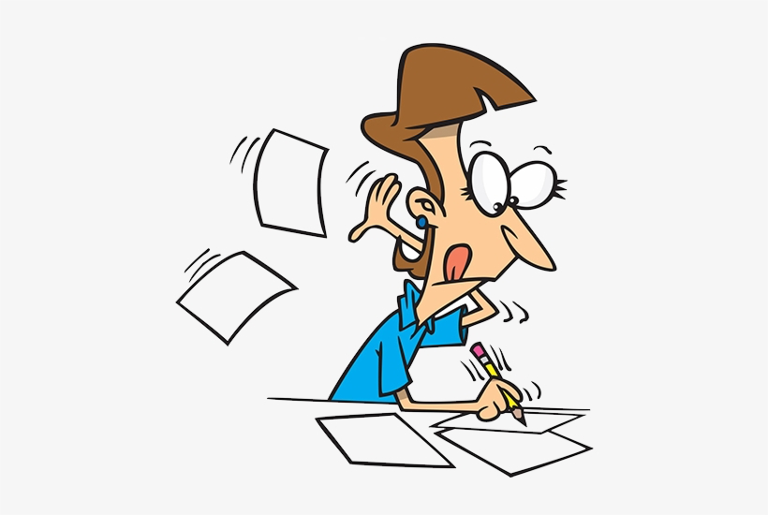
History - The Australian Colonies
Key Inquiry Question:
How did an Australian colony develop over time and why?
Watch the video ‘A Colonial Puzzle’ and notetake the big ideas presented in the video of reasons for further colonisation in Australia https://www.inquisitive.com/video/266-a-colonial-puzzle
Historians use specific terms when describing and categorising historical events. There were economic, political and social reasons for the development of the Australian colonies after 1800.
Watch the video ‘Word Professor’ https://www.inquisitive.com/audio/267-word-professor Then write down what economic, political and social means.

Slide 37
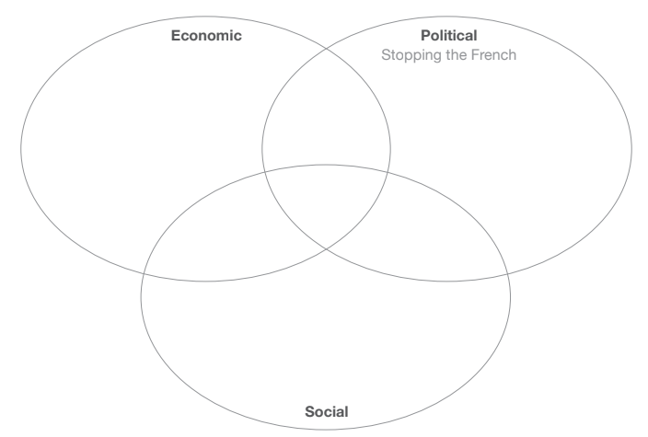
History - The Australian Colonies
Key Inquiry Question:
How did an Australian colony develop over time and why?
Using your big ideas from the first video ‘A Colonial Puzzle’, categorise the reasons for the development of the colonies by completing the Venn diagram. Are there any that you think overlap two categories, or maybe all three?

Slide 38
Fast Finishers

