Slide 1
approximate
Definition: to estimate or be near
Part of Speech: verb or adjective
Synonym: approach
Antonym: perfect
Example sentence: I only need to approximate the amount of water I give to the plants because the moisture in the soil helps me determine if they have enough.

Slide 2
brief
Definition: of short duration
Part of Speech: adjective, noun, or verb
Synonym: short
Antonym: long
Example sentence: I watched a brief video about how to use a sewing machine.

Slide 3
clarify
Definition: to make clear
Part of Speech: verb
Synonym: simplify
Antonym: confuse
Example sentence: The teacher clarified the confusing homework assignment.

Slide 4
classify
Definition: to arrange into categories
Part of Speech: verb
Synonym: categorize
Antonym: disorganize
Example sentence: Linnaeus classified living things into groups called kingdoms.

Slide 5
compatible
Definition: able to exist or occur together without conflict
Part of Speech: adjective
Synonym: in harmony
Antonym: incompatible
Example sentence: Peanut butter and jelly are compatible flavors.

Slide 6
denominator
Definition: the bottom part of a fraction
Part of Speech: noun
Synonym: fraction bottom
Antonym: numerator
1
2
Example sentence: The denominator in one-half is two.

Slide 7
determine
Definition: firmly decide
Part of Speech: verb
Synonym: decide
Antonym: undetermined
Example sentence: His fate was determined when the principal gave him a detention.

Slide 8
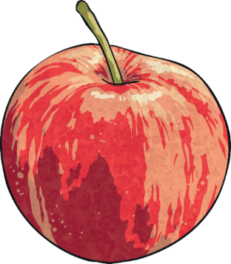
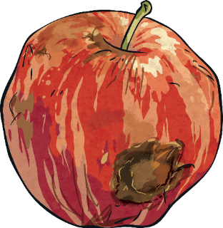
distinguish
Definition: recognize or treat as different
Part of Speech: verb
Synonym: differentiate
Antonym: group together
Example sentence: He distinguished the good apples from the bad ones.

Slide 9
equivalent
Definition: equal in value
Part of Speech: adjective
Synonym: equal
Antonym: different
1
3
2
6
Example sentence: Six eggs is equivalent to half a dozen.

Slide 10
evaluate
Definition: form an idea of the amount or value of
Part of Speech: verb
Synonym: assess
Antonym: criticize
Example sentence: The teacher evaluates the students’ learning with tests and projects.

Slide 11
formulate
Definition: create or devise a strategy
Part of Speech: verb
Synonym: develop
Antonym: deconstruct
Example sentence: She formulated a hypothesis for her science project.

Slide 12
generate
Definition: cause something to come about
Part of Speech: verb
Synonym: produce
Antonym: destroy
Example sentence: The solar panels generate electricity.

Slide 13
influence
Definition: the power to have an effect on something
Part of Speech: noun, verb
Synonym: effect
Antonym: discourage
Example sentence: He had a positive influence on his younger sister because he taught her good manners.

Slide 14
justify
Definition: to show or prove to be right or reasonable
Part of Speech: verb
Synonym: rationalize
Antonym: denounce
Example sentence: She justified her decision to rest because she missed sleep the night before.

Slide 15
media
Definition: the main means of mass communication
Part of Speech: noun
Synonym: communicants
Antonym: hermits
Example sentence: The media make many reports in print, online, on the radio, and on television.

Slide 16
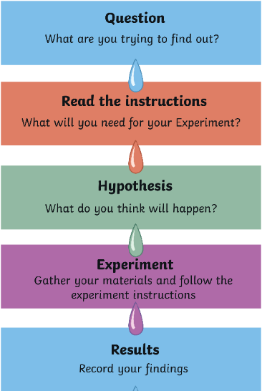
method
Definition: a procedure for accomplishing something
Part of Speech: noun
Synonym: procedure
Antonym: disorder
Example sentence: She followed the scientific method for her science experiment.

Slide 17
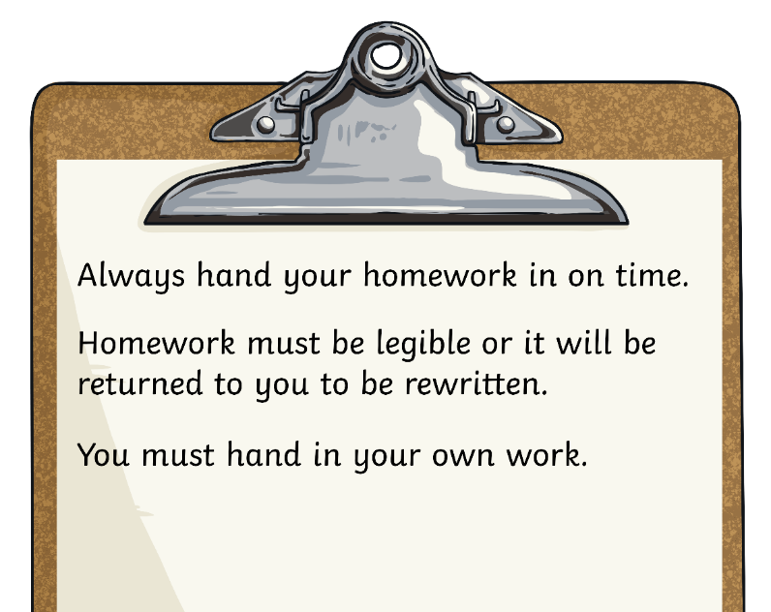
policy
Definition: a course of action
Part of Speech: noun
Synonym: strategy
Antonym: without plan
Example sentence: The late homework policy was that it would not be accepted.

Slide 18
procedure
Definition: a way of doing something
Part of Speech: noun
Synonym: strategy
Antonym: random
Boil water in the kettle
Pour water into a pan
Add pasta to the pan
Add salt (optional)
Cook according to instructions on packet
Drain water and serve
Example sentence: The procedure for cooking pasta includes boiling water, adding the pasta, and draining the water.

Slide 19
quantity
Definition: the amount or number of something
Part of Speech: noun
Synonym: amount
Antonym: deficiency
2
4
1
3
Example sentence: The quantity of grains of sand is impossible to count.

Slide 20
refer
Definition: to mention or pass a matter to
Part of Speech: verb
Synonym: involve
Antonym: exclude
Example sentence: She referred to the encyclopedia for information about mountain lions.

Slide 21
relationship
Definition: the way in which two or more things are connected
Part of Speech: noun
Synonym: connection
Antonym: disassociation
Example sentence: There is a relationship between amount of time reading and amount of books read.

Slide 22
represent
Definition: be entitled to act or speak for someone
Part of Speech: verb
Synonym: substitute
Antonym: distort
8 x n = 32
Example sentence: The variable in an equation represents a number.

Slide 23
stereotype
Definition: an oversimplified idea, to oversimplify an idea
Part of Speech: noun, verb
Synonym: cliche
Antonym: unconventional
Example sentence: It is not a good idea to stereotype groups of people, because usually there is an exception to the idea.

Slide 24
technique
Definition: a way of carrying out a particular task
Part of Speech: noun
Synonym: method
Antonym: chaos
Example sentence: The chef’s technique for slicing apples resulted in perfectly equal-sized pieces.

Slide 25
validate
Definition: to prove the truth or value of
Part of Speech: verb
Synonym: prove
Antonym: disprove
Example sentence: She validated the ticket.

Slide 26
Which vocabulary words are related to math?
quantity
procedure
method
evaluate
equivalent
denominator
approximate

Slide 27
Which vocabulary words have a meaning similar to strategy or routine?
technique
procedure
method

Slide 28
Which vocabulary words refer to the connections among things?
relationship
compatible
represent
refer
influence

Slide 29
Which vocabulary words refer to grouping things?
stereotype
equivalent
distinguish
compatible
classify
clarify

Slide 30
Which vocabulary words would you group together?
?

